Slide 3
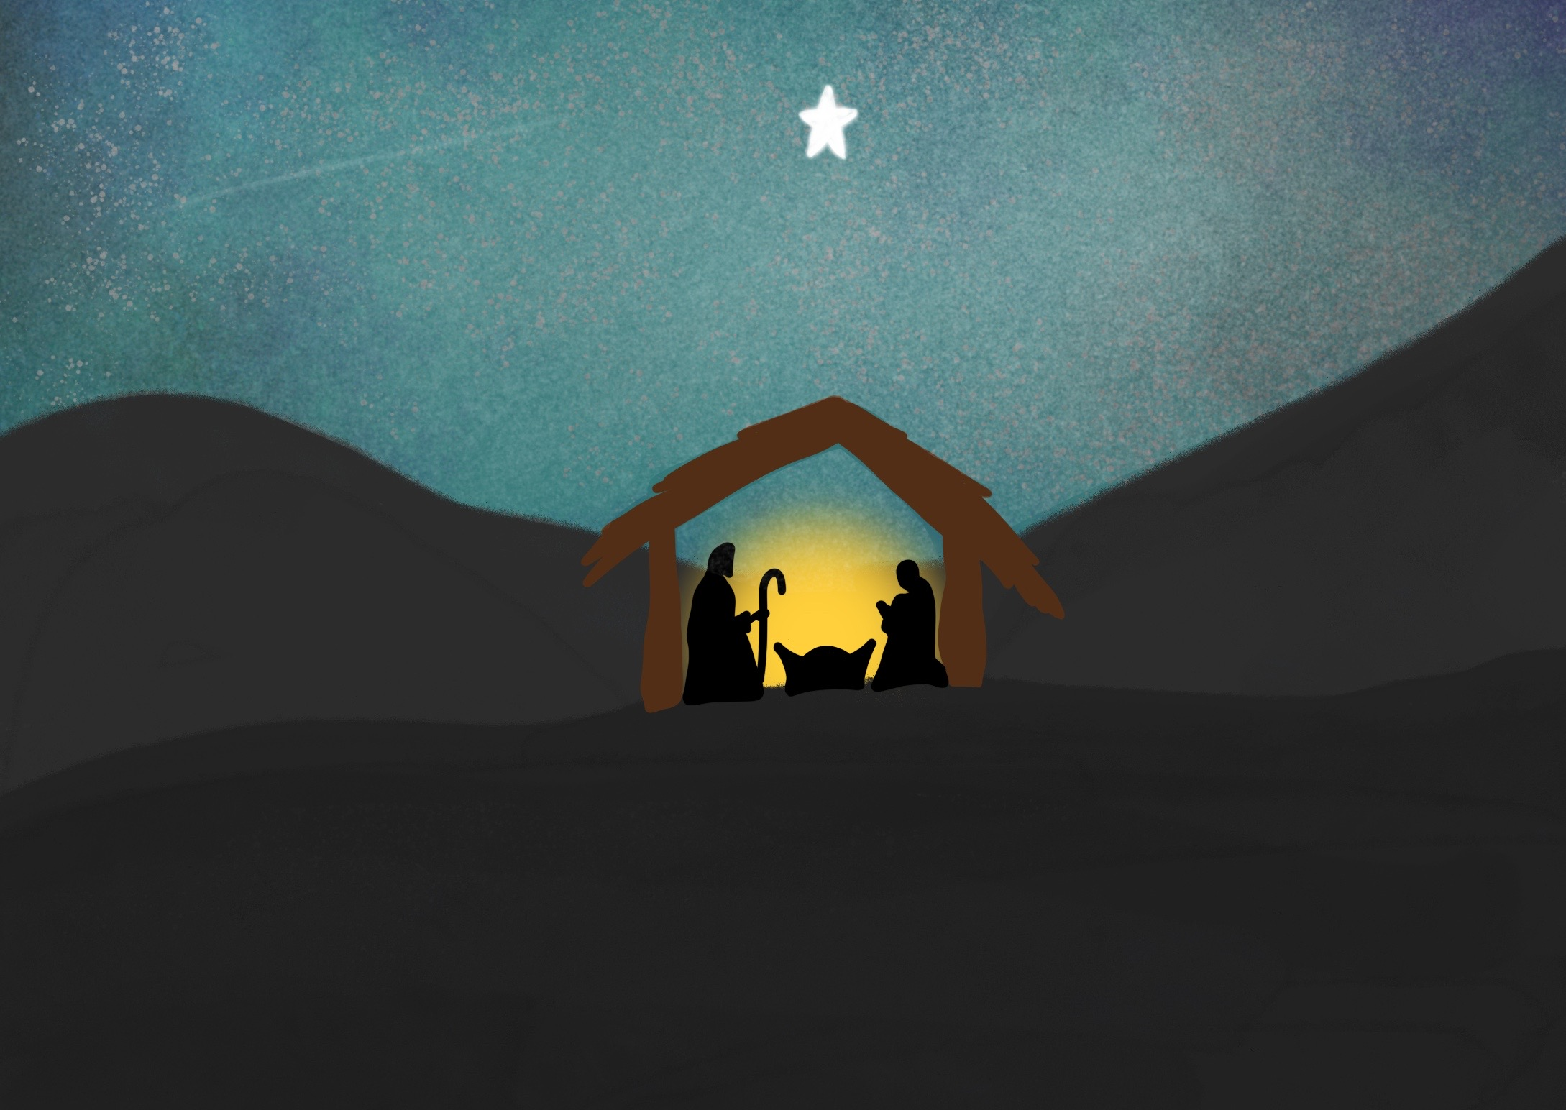

Slide 4
Angels announced the Good News of His birth,

Slide 5
God showed his love by sending his son to be our Saviour

Slide 6
Getting ready for Christmas

Slide 10
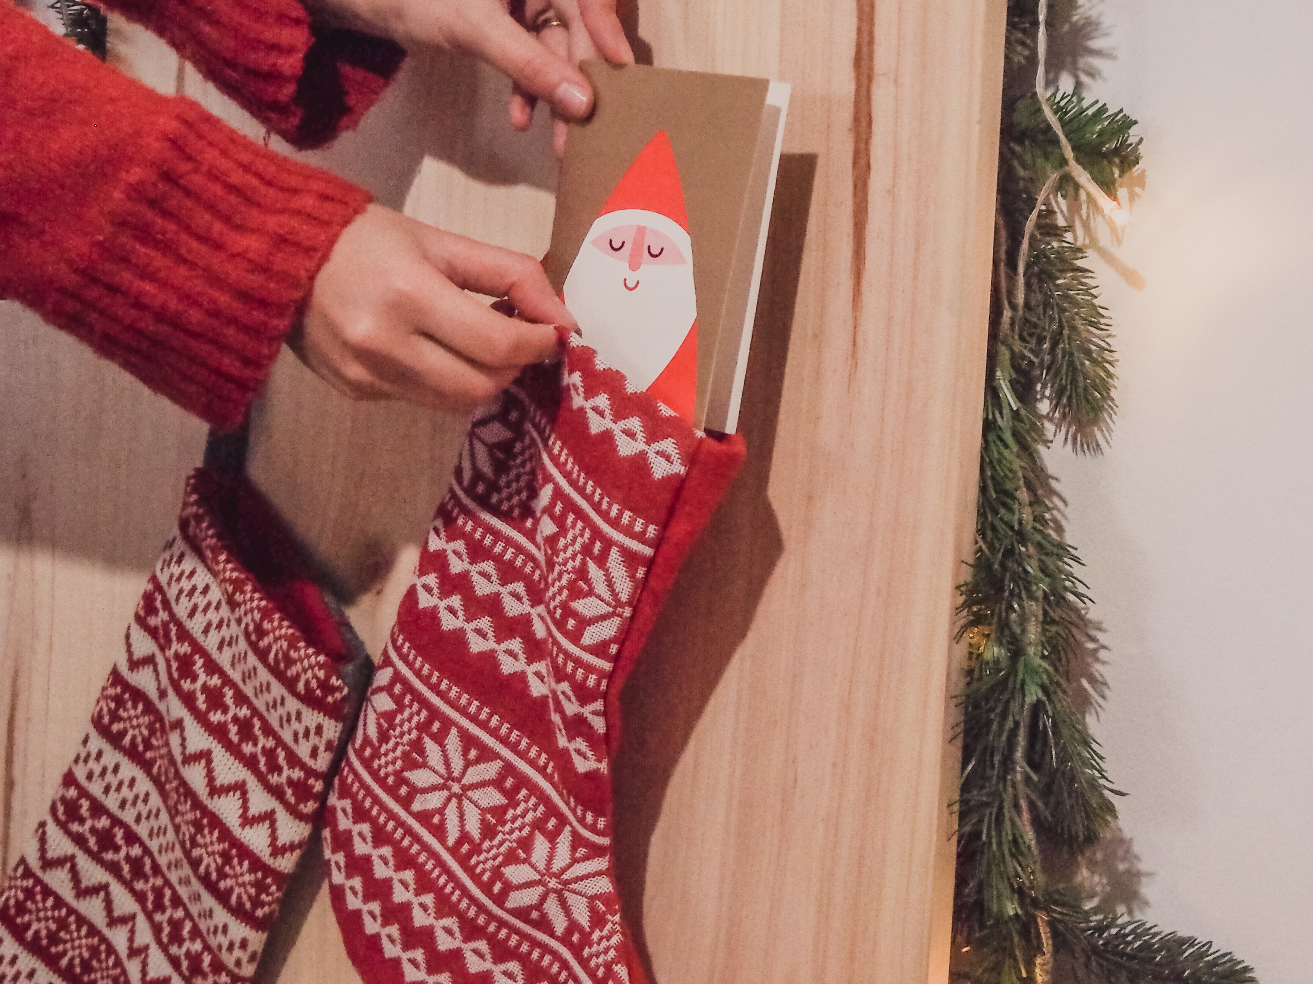

Slide 11
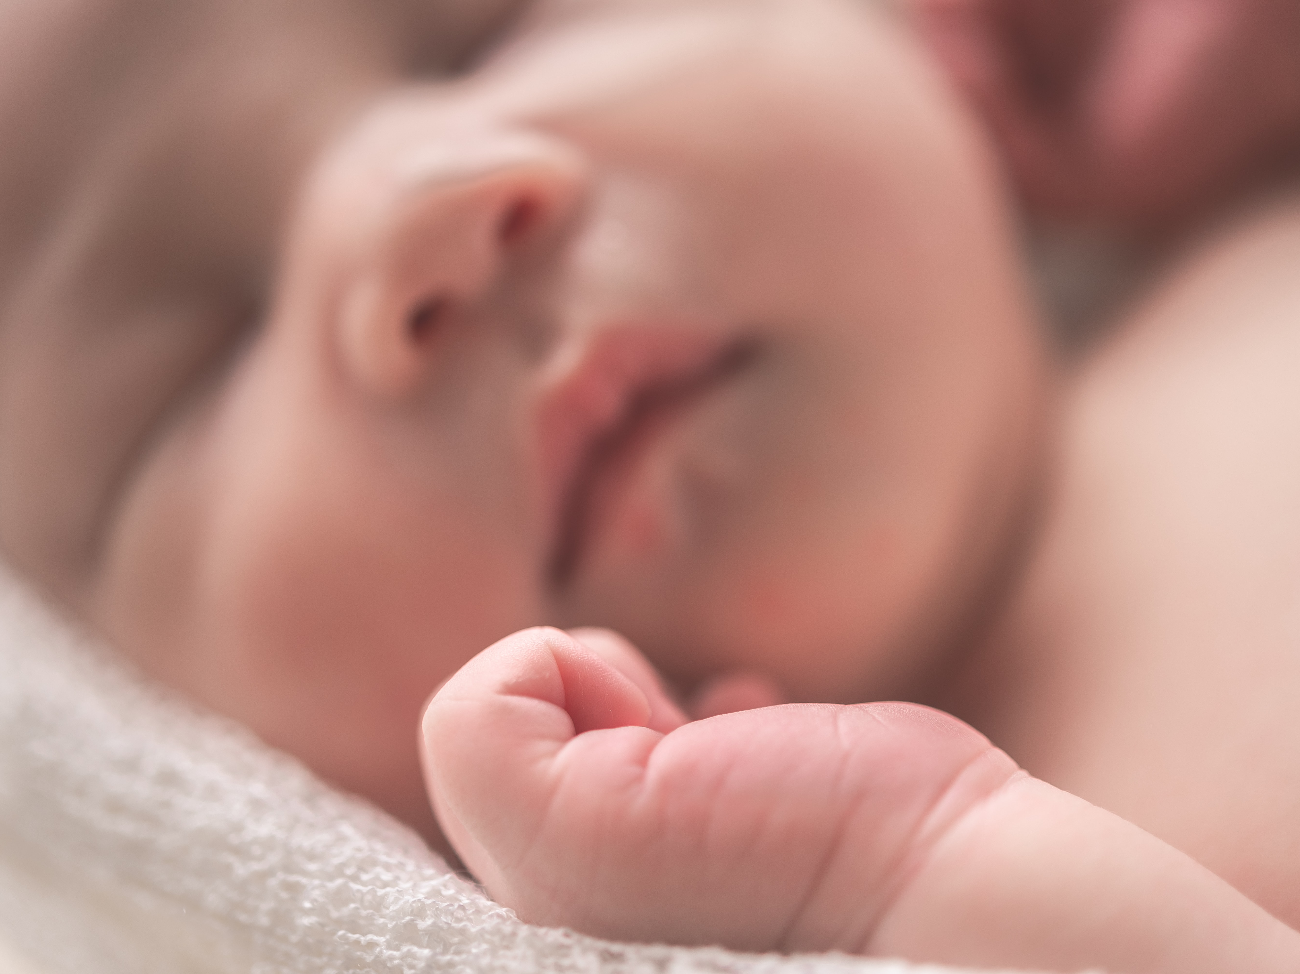

Slide 12
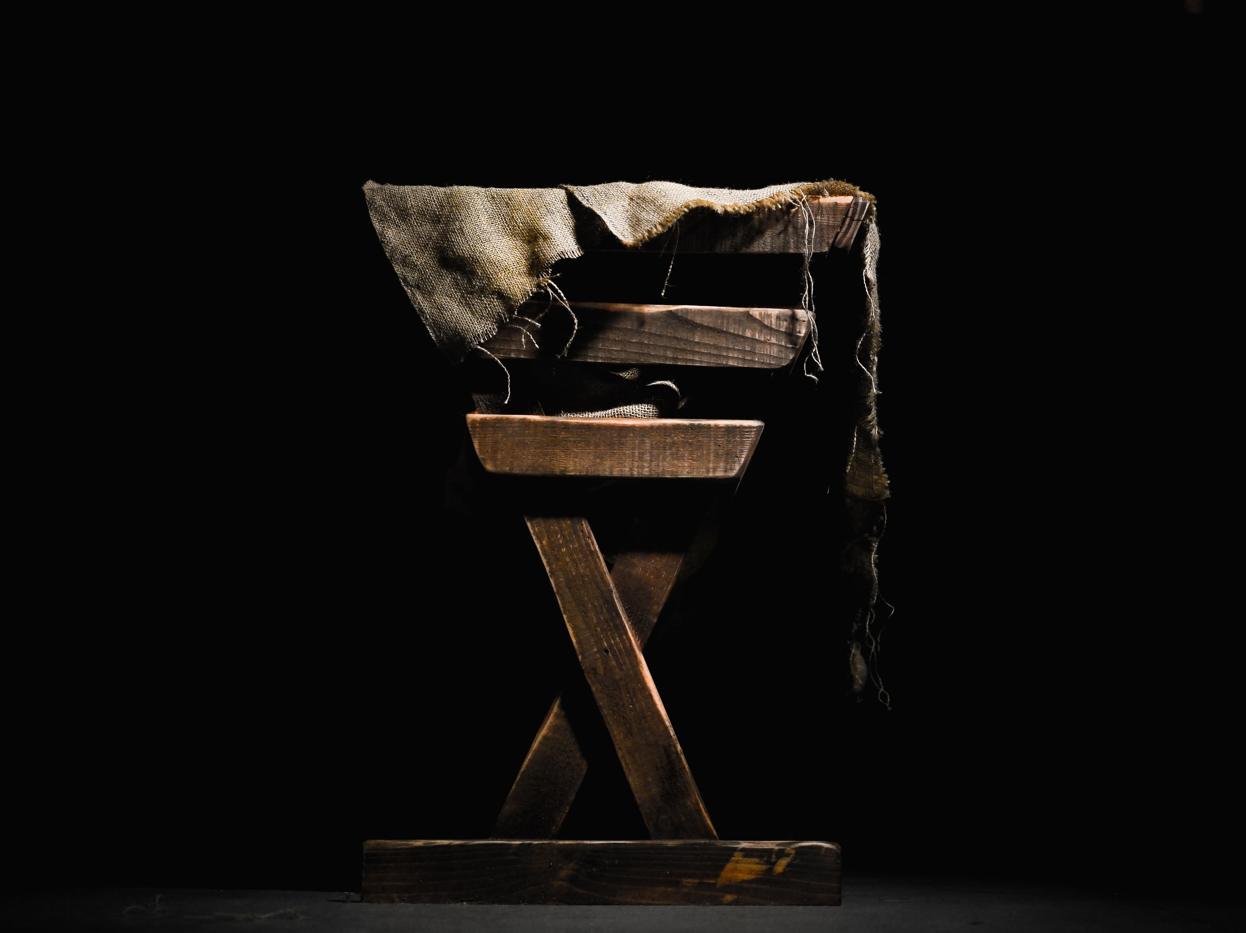

Slide 14
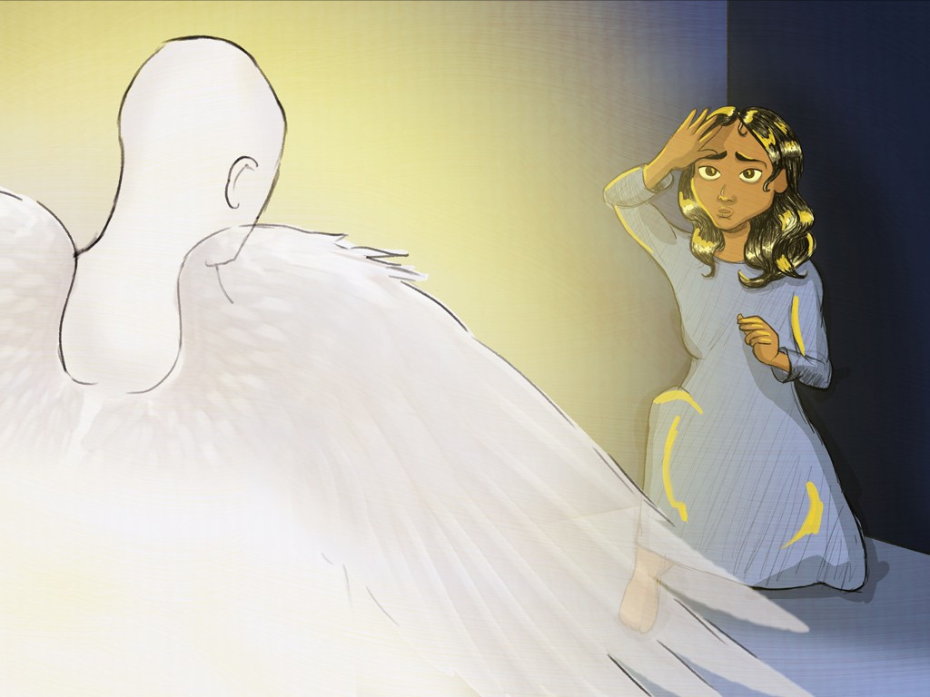

Slide 15
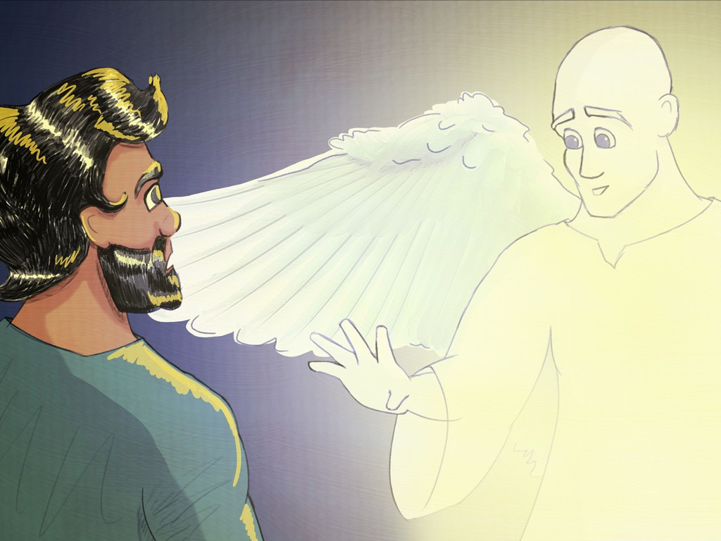

Slide 16
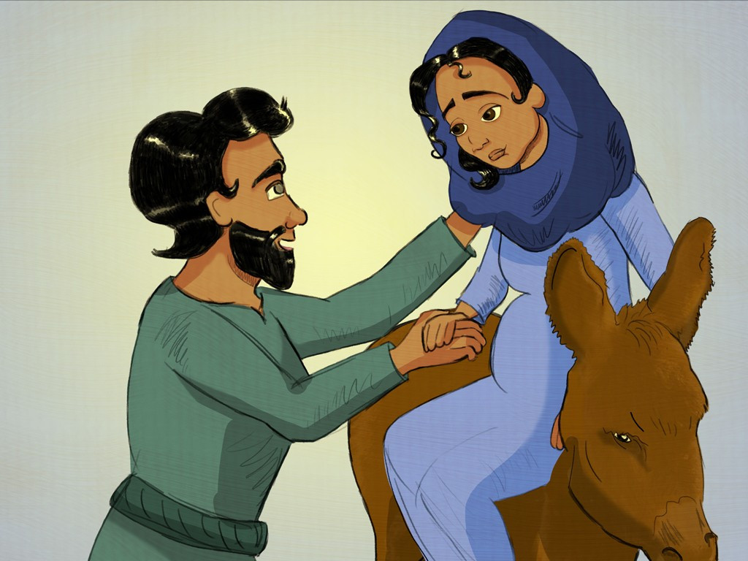

Slide 17
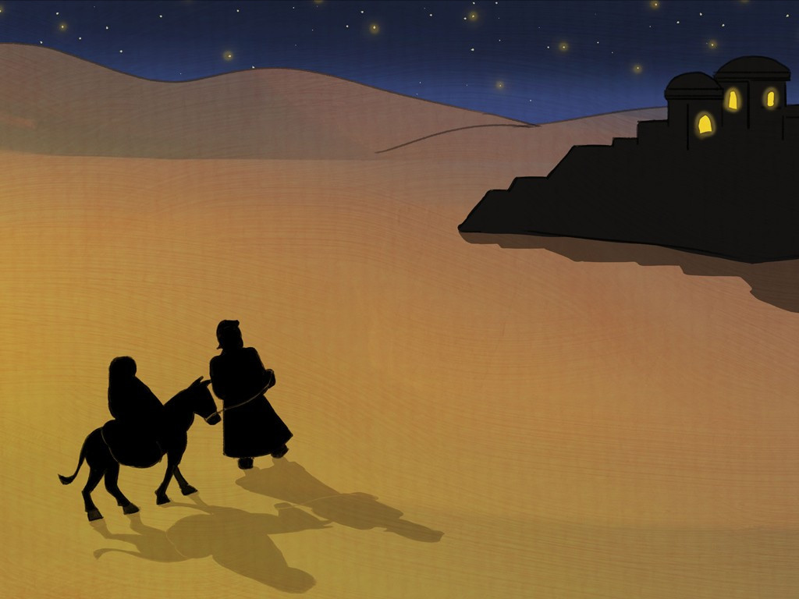

Slide 18
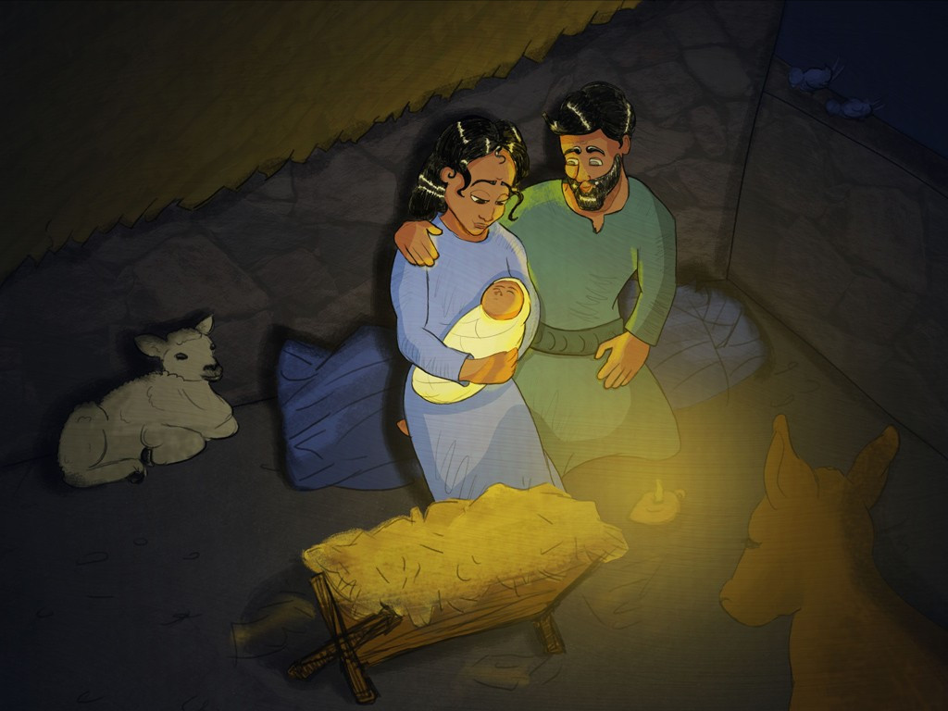

Slide 19
God loved the people of this world so much that he gave his only Son…
John 3:16

Slide 20
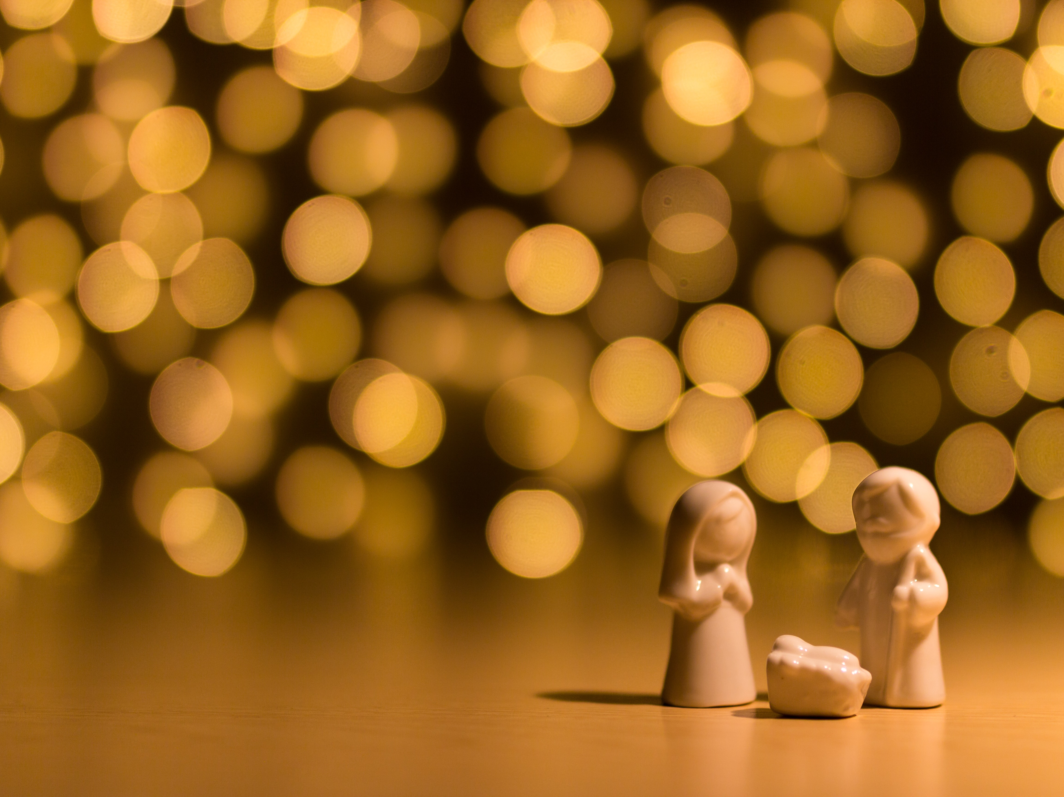
Little things mean the most

