Slide 1
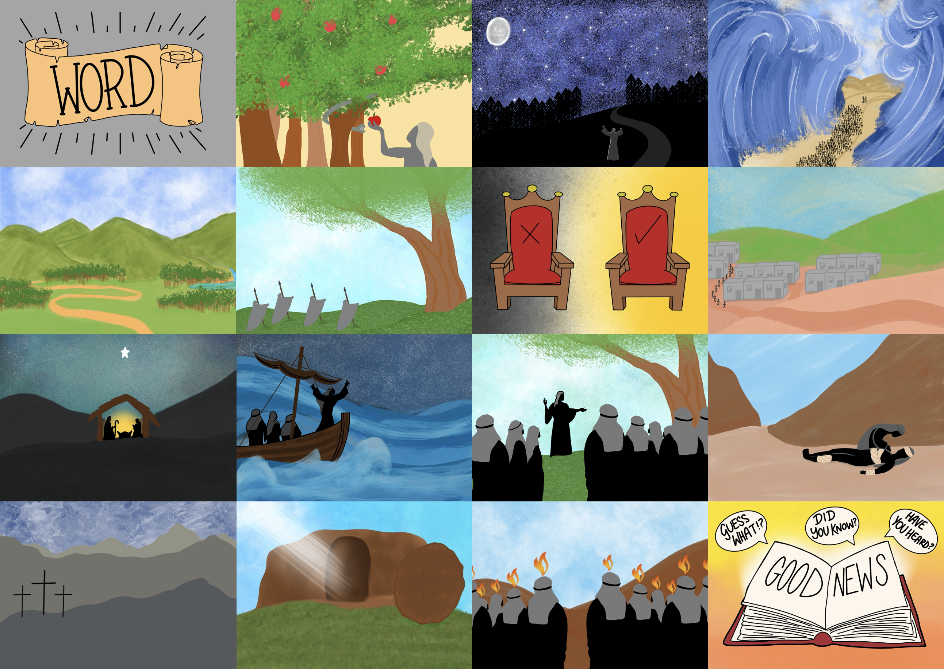

Slide 3
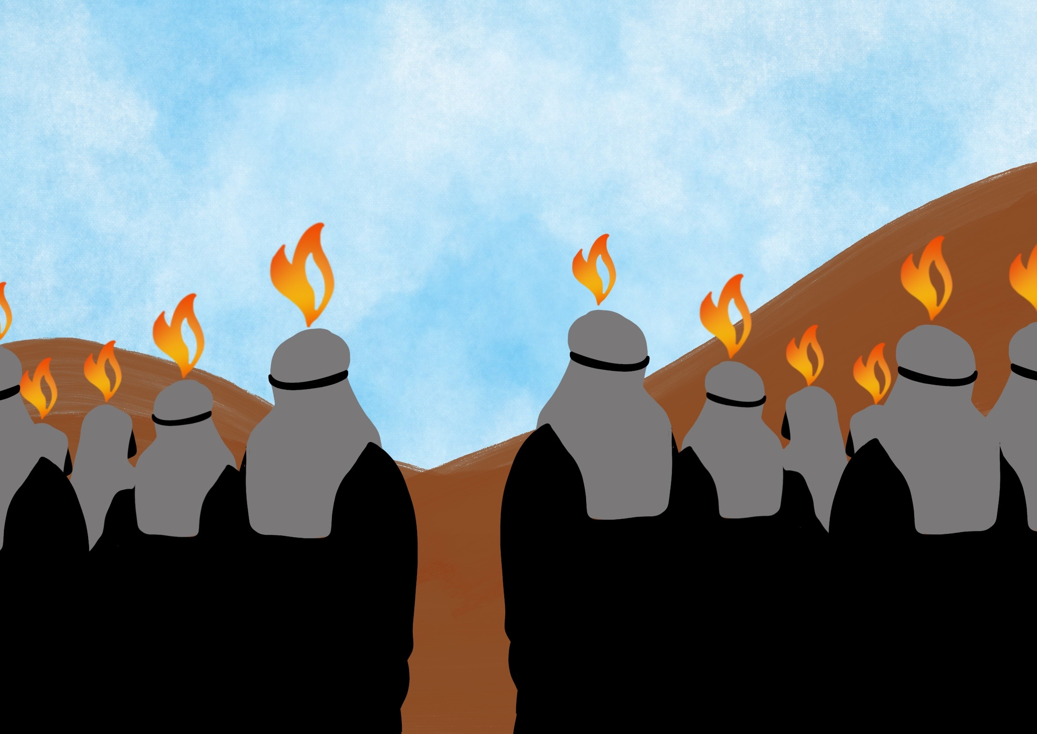

Slide 4
He has given us His Spirit to help us since then,

Slide 5
The Holy Spirit helps us to understand God’s word

Slide 6
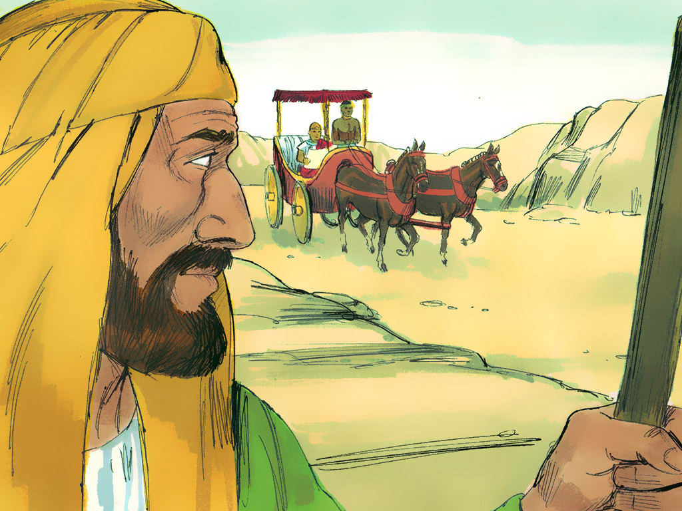

Slide 7
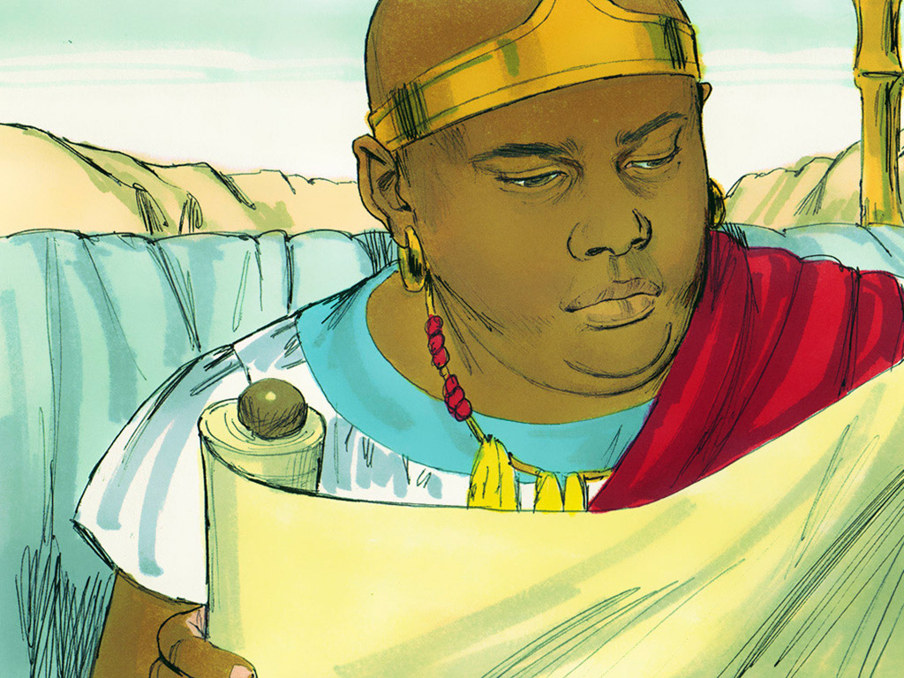
An opportunity to READ it

Slide 8
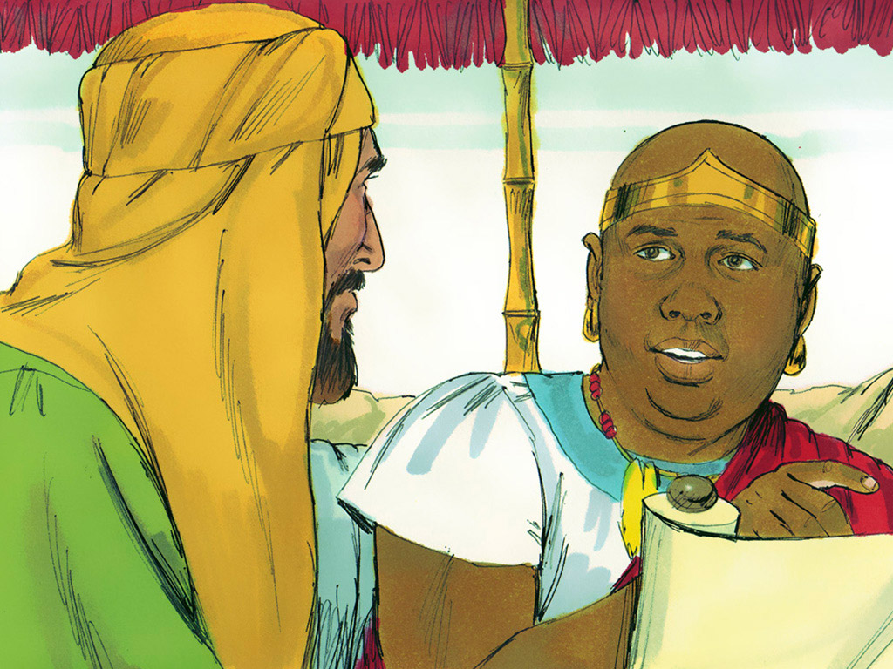
An opportunity to UNDERSTAND it

Slide 9
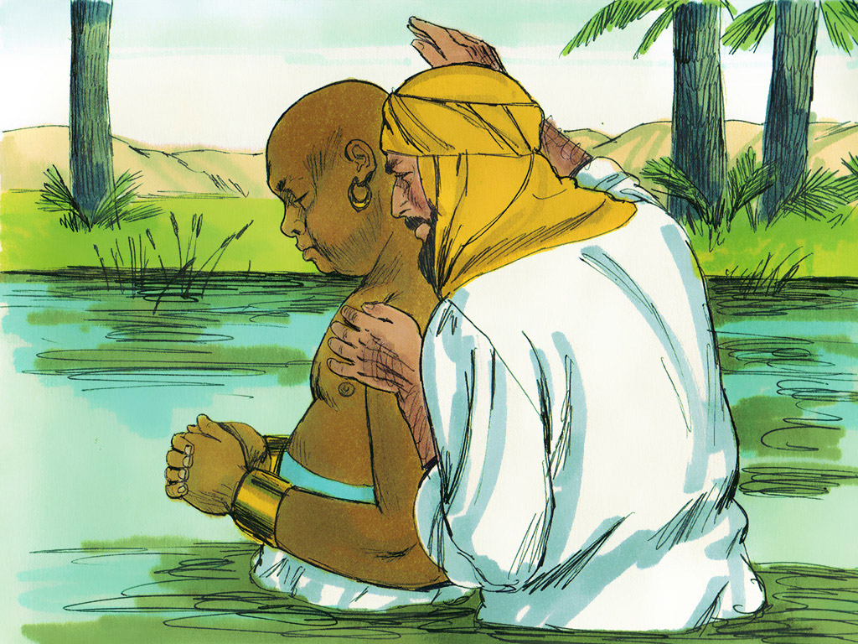
An opportunity to OBEY it

Slide 10
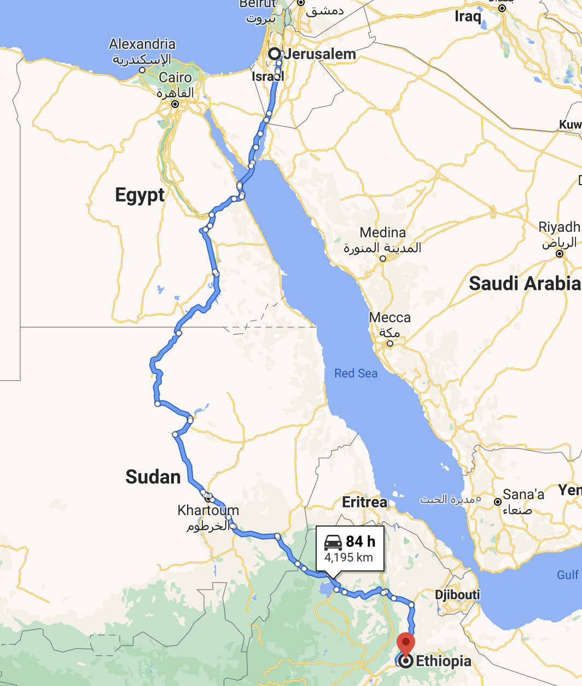

Slide 11
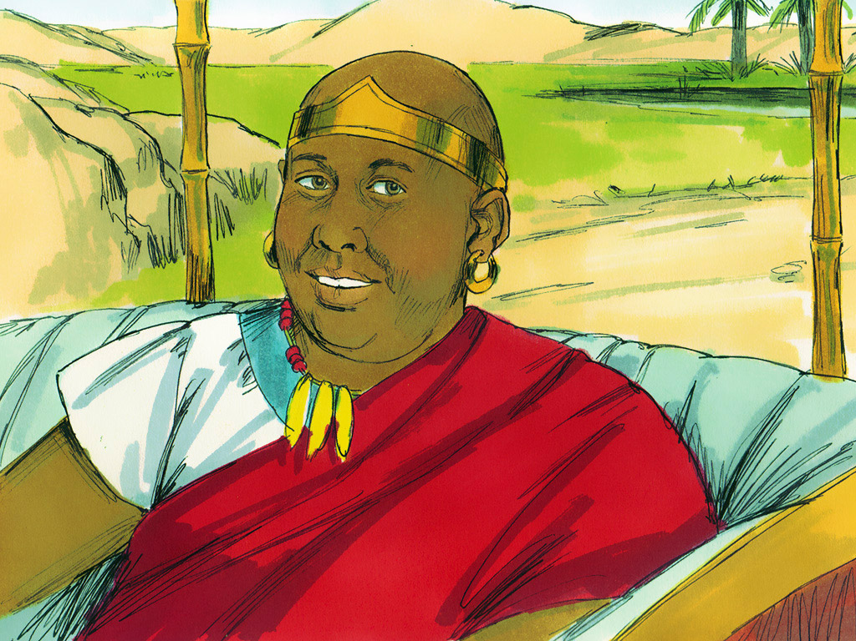
An opportunity to SHARE it

