Slide 3
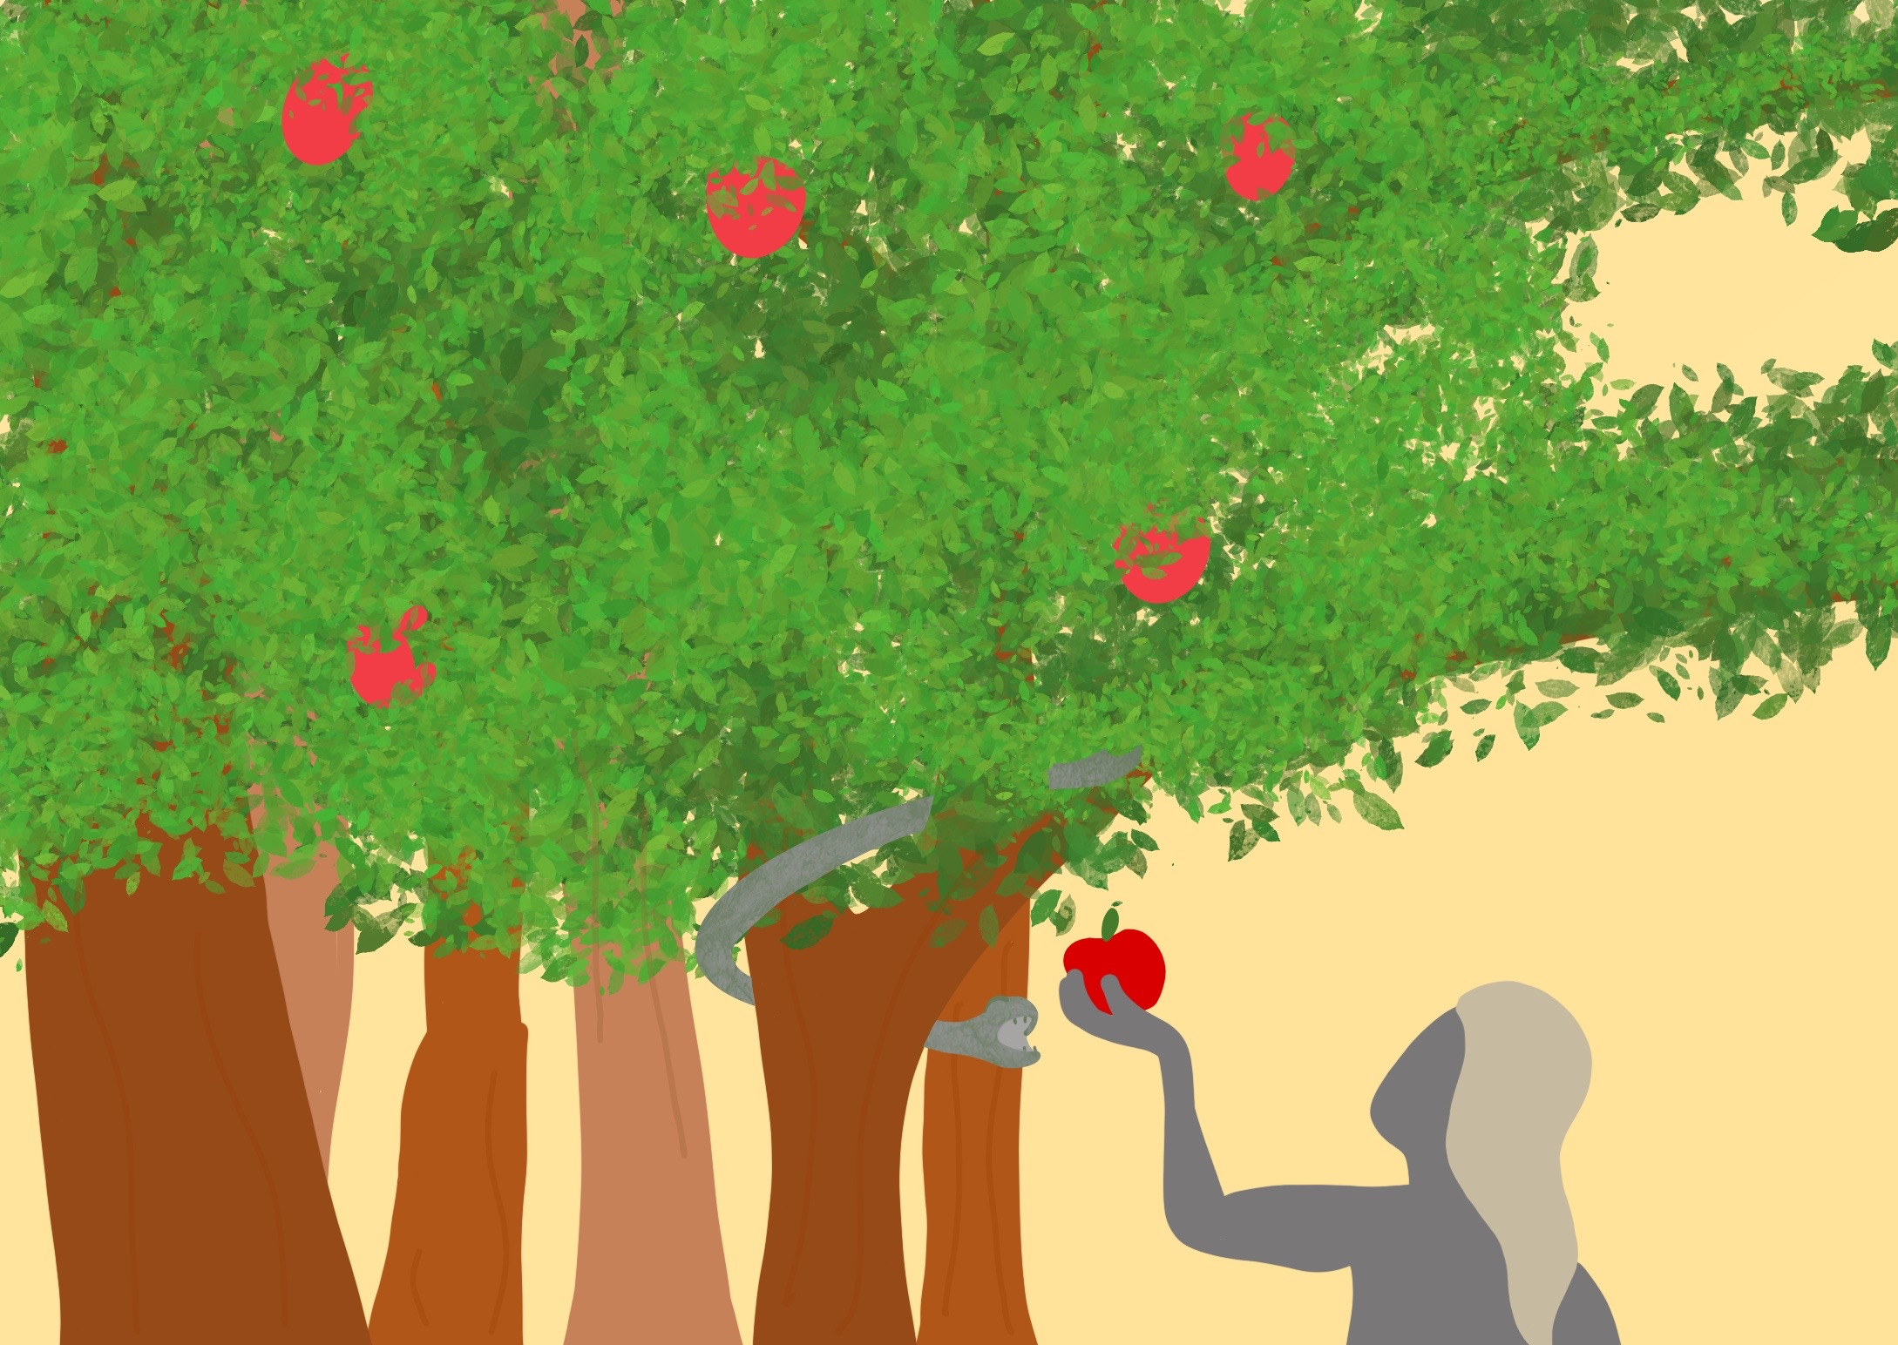

Slide 4
In God’s perfect world when wrong things began…

Slide 5
In the beginning God gave us a choice

Slide 6
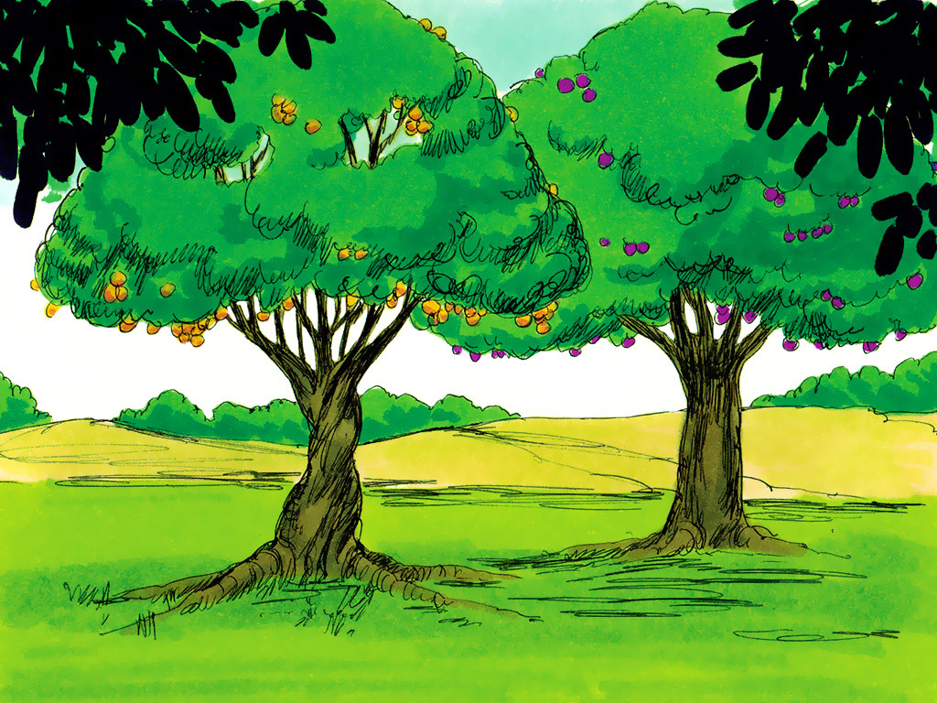

Slide 8
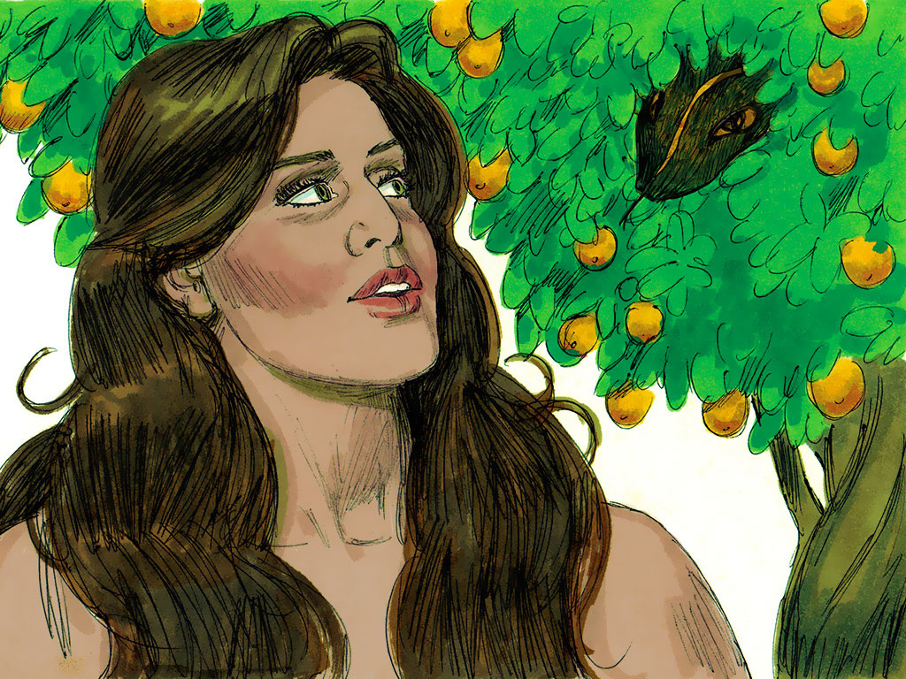

Slide 9
Do what God says
Do what you want

Slide 11
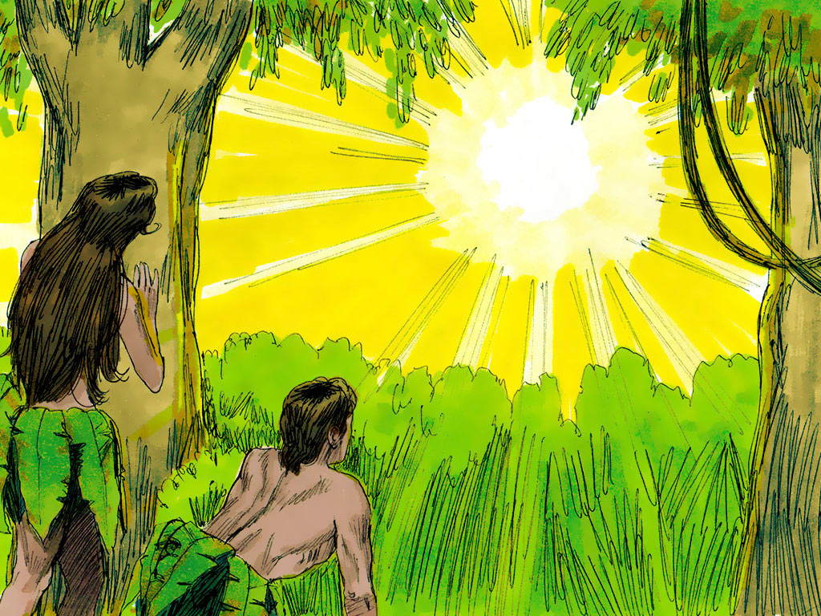

Slide 12
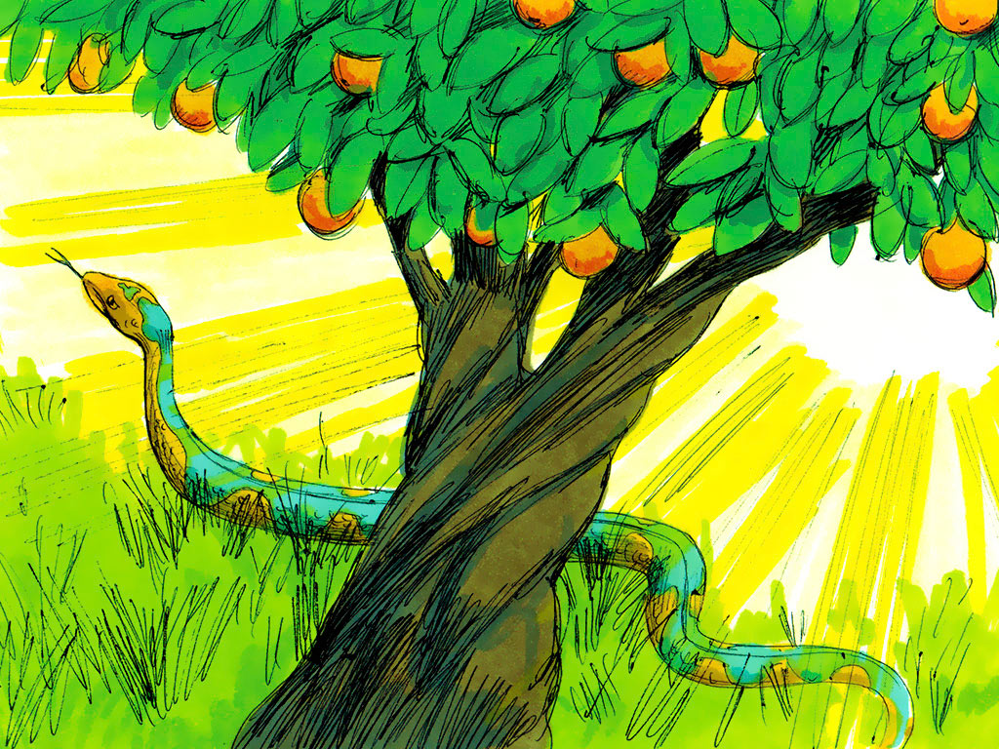

Slide 13
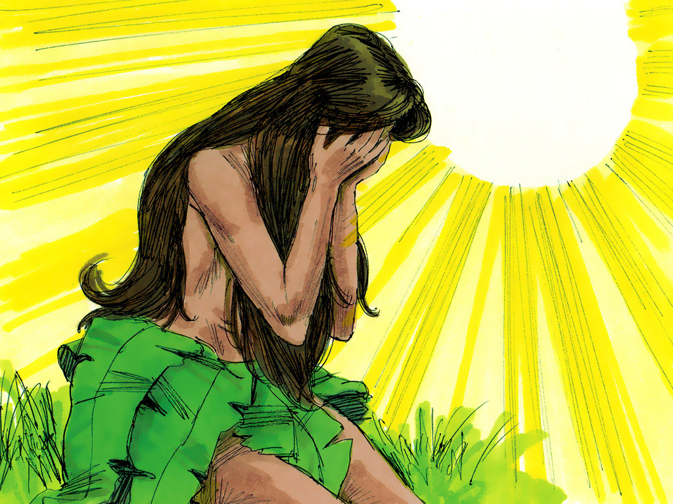

Slide 14
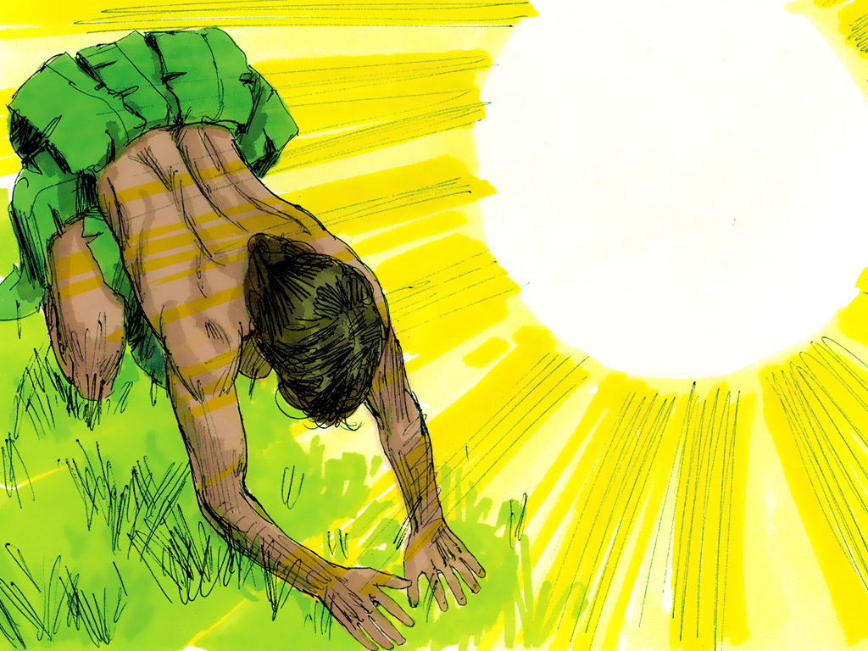

Slide 15
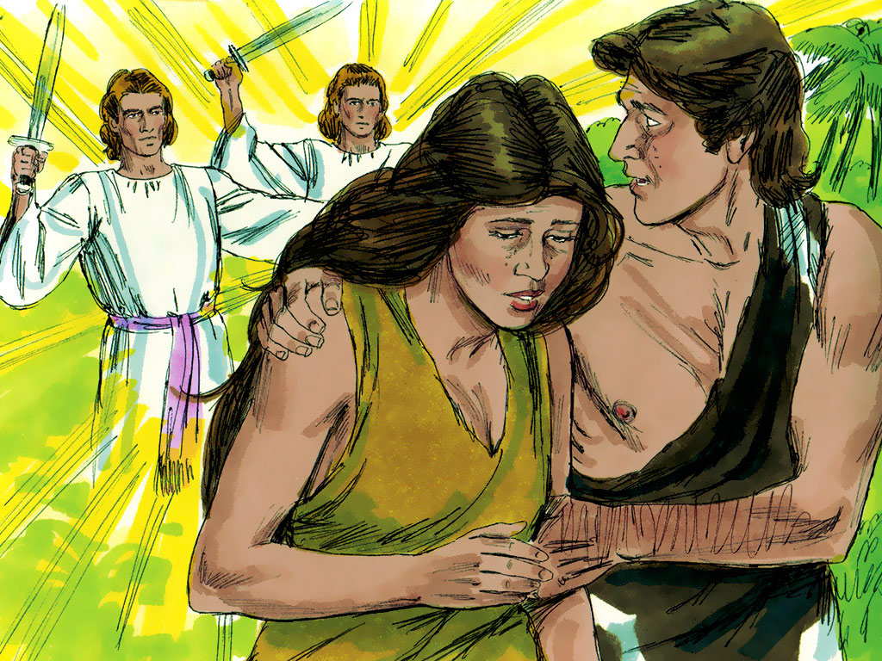

Slide 16
Do what God says
Do what you want

