Slide 3
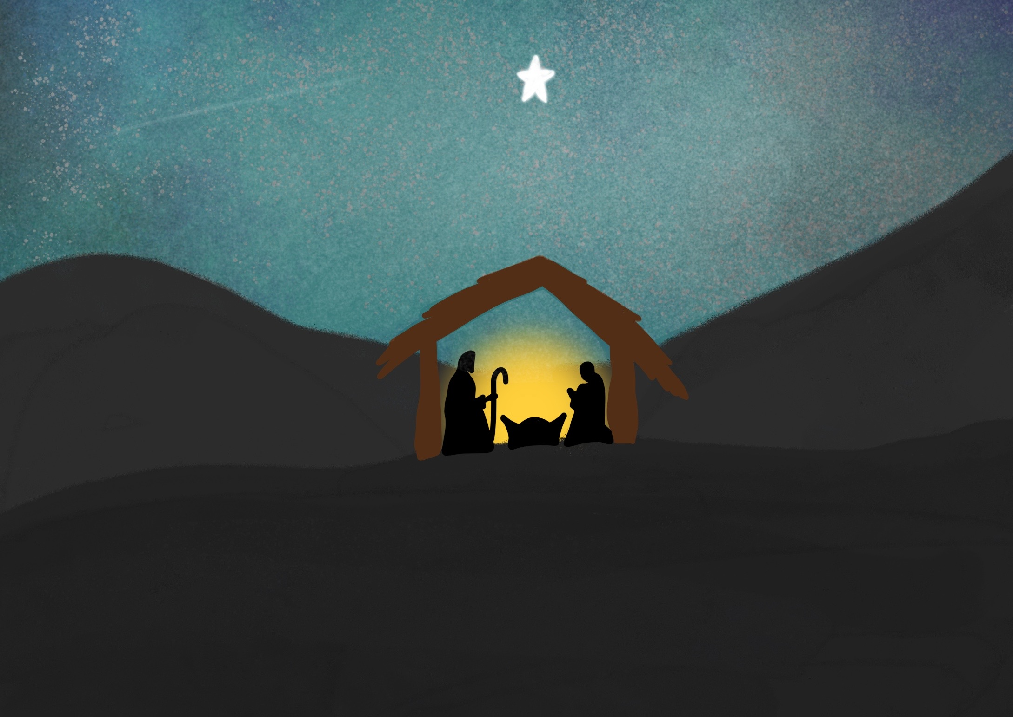

Slide 4
Angels announced the Good News of His birth,

Slide 5
The gift of God’s love is for everyone

Slide 8
God loved the people of this world so much that he gave his only Son,
so that everyone who has faith in him will have eternal life and never really die.
John 3:16

Slide 9
With love from God

Slide 10
Yet some people accepted him and put their faith in him. So he gave them the right to be the children of God.
John 1:12

Slide 11
To all who believe
With love from God

Slide 12
This is the stable warm and dry,
This is that star that shone in the sky,
This is the baby who came from above,
To bring us the wonderful gift of God’s love.

