Slide 3
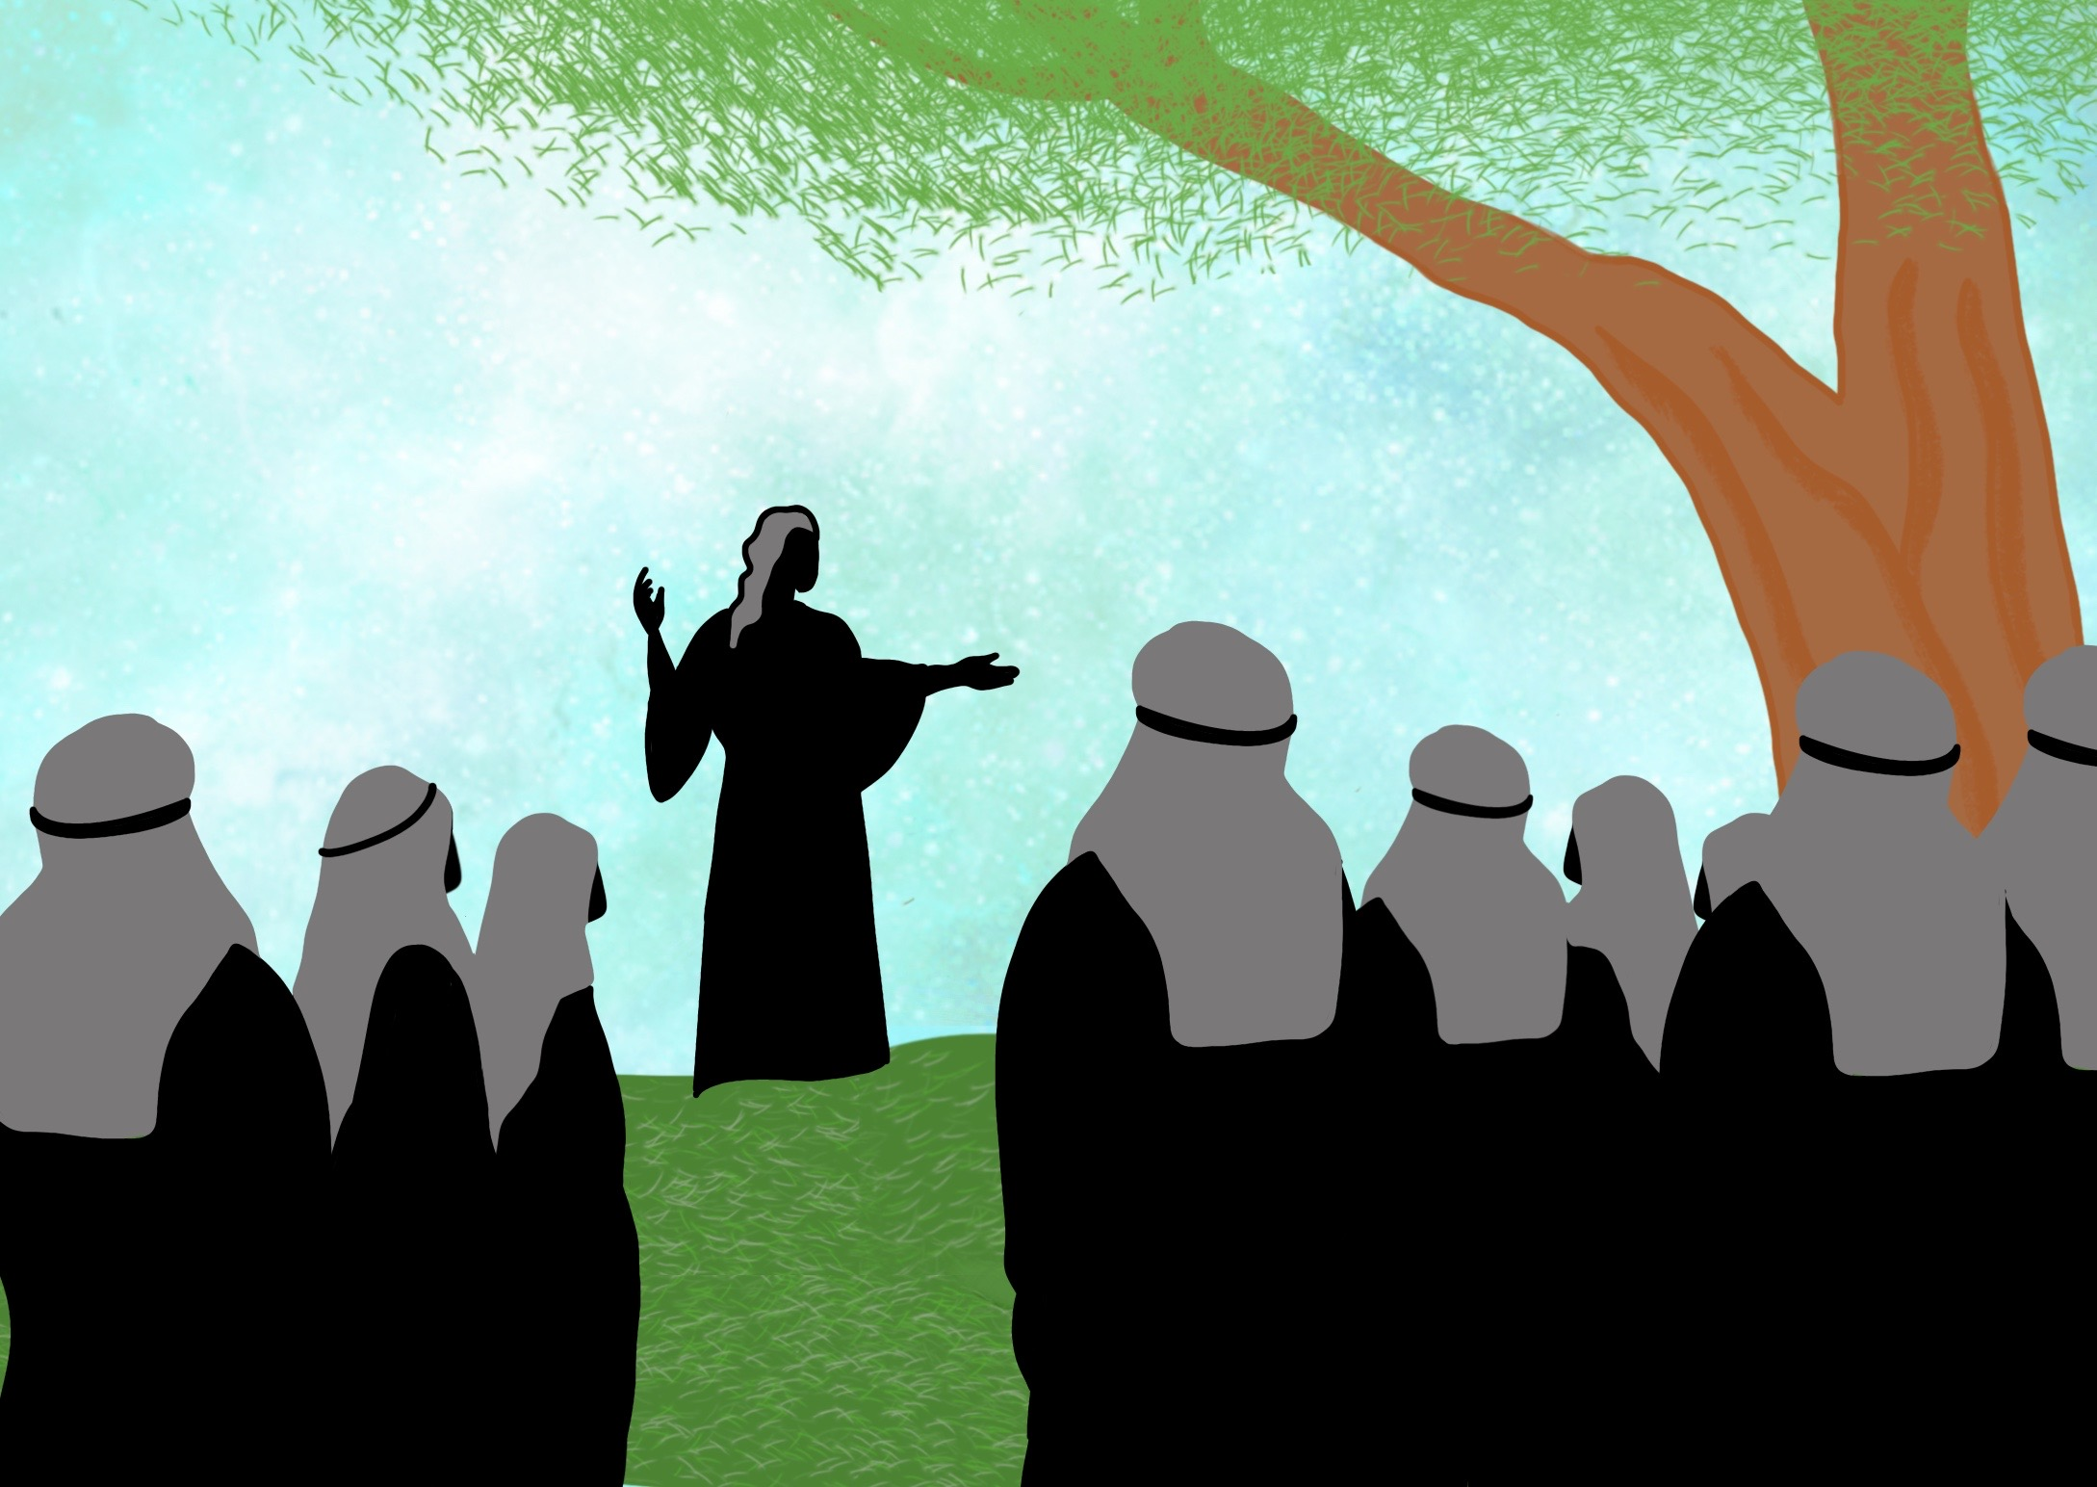

Slide 4
He brought us Good News from the Father above,

Slide 5
The kingdom of Heaven is like a big party

Slide 8
PARTY!!!!

Slide 13
I’m so sorry.
I can’t come because….
EXCUSES
I can’t come either.
I have to….
I’m afraid today is no good for me because….

