Slide 1
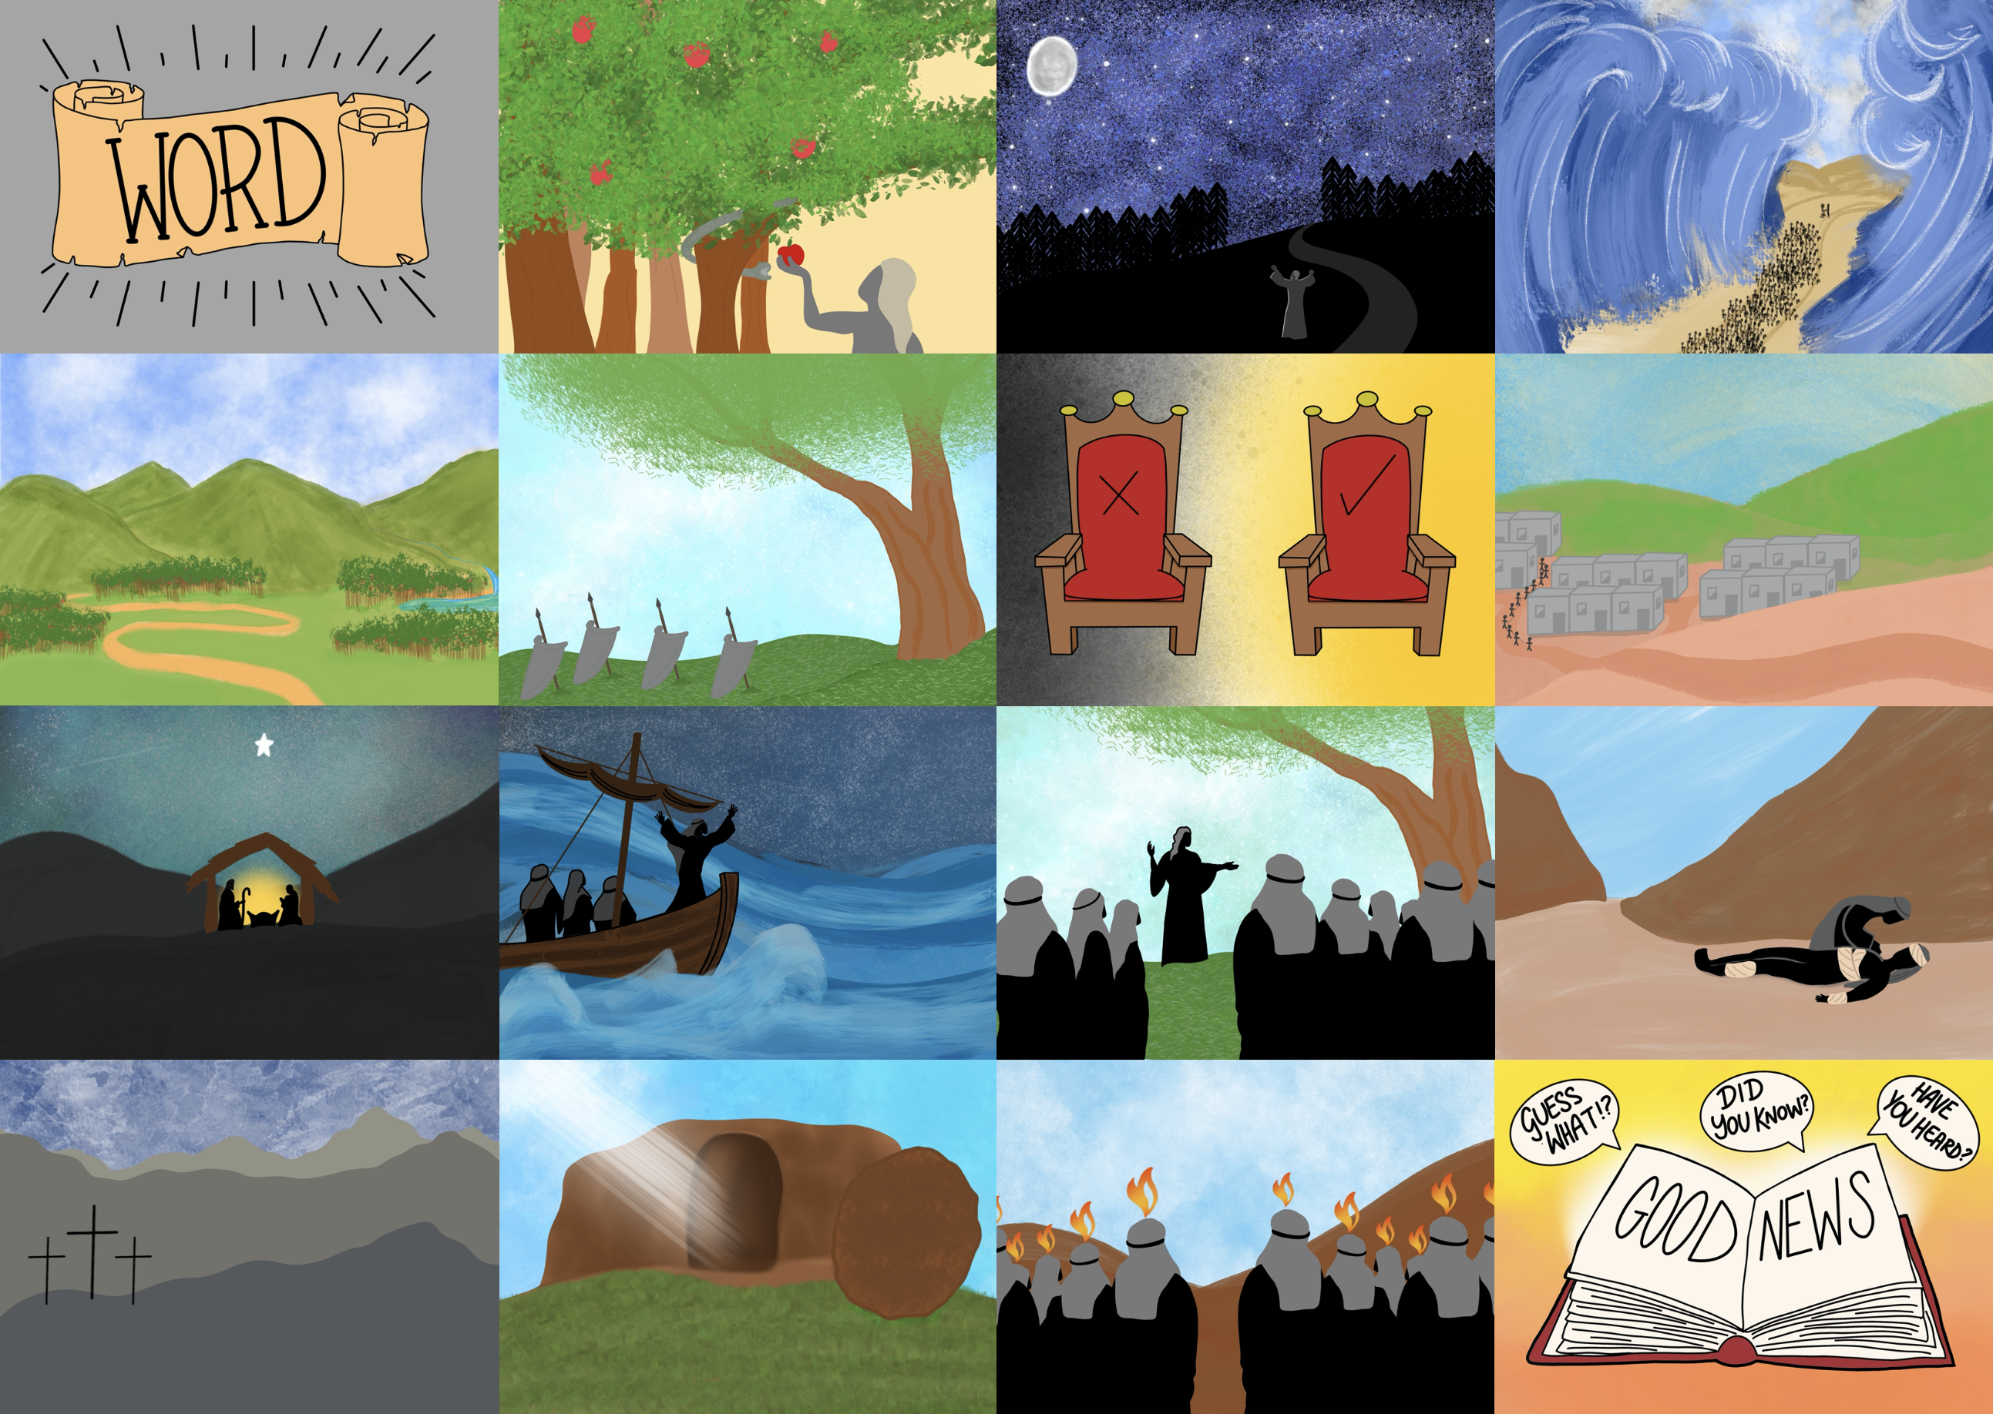

Slide 3
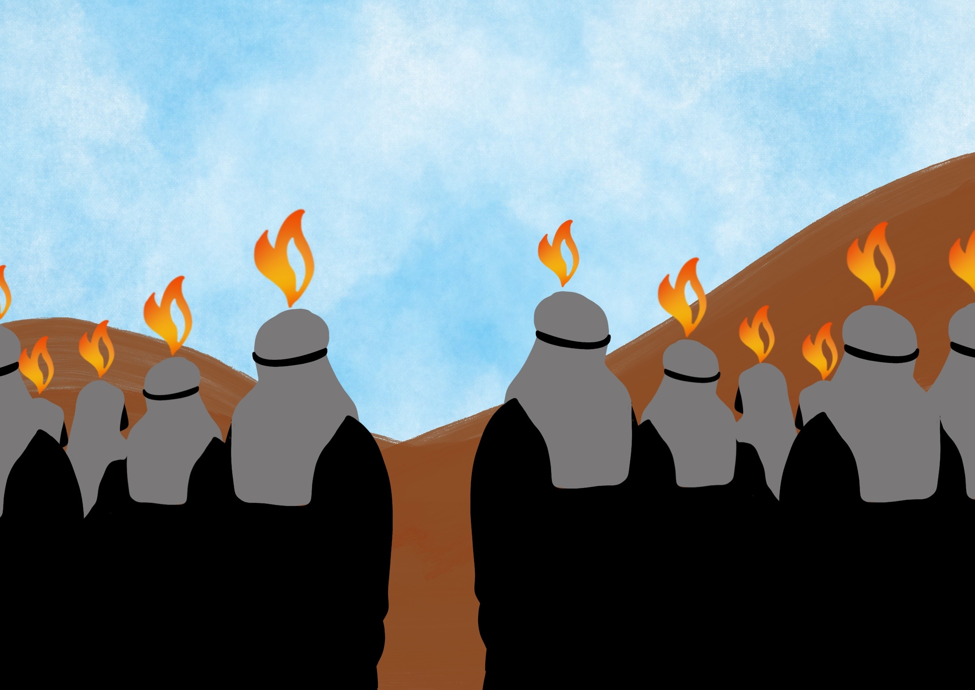

Slide 4
He has given us His Spirit to help us since then,

Slide 5
The first Christians loved one another

Slide 6
Insert pictures of local church buildings

Slide 7
Insert pictures of people who are part of your church and activities they can be involved in together.

Slide 8
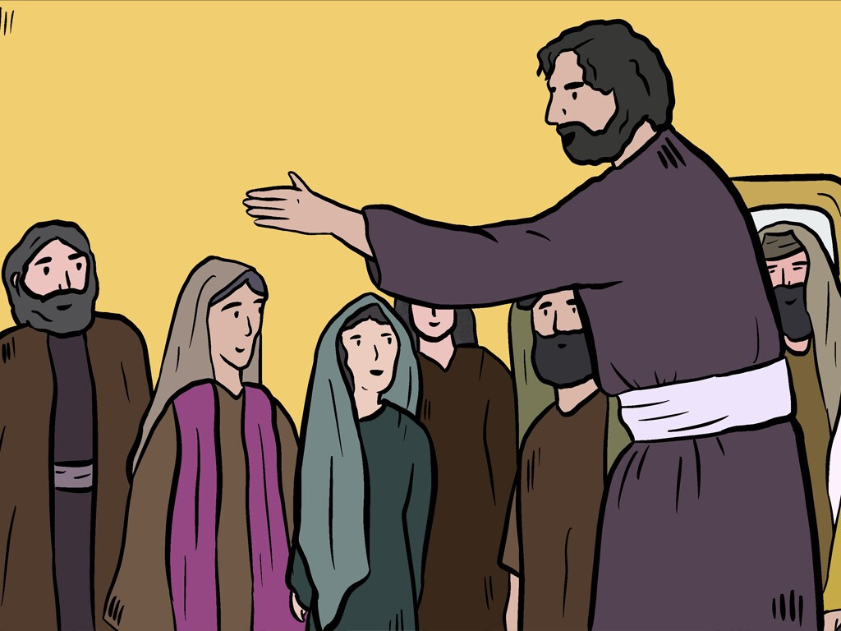
The believers spent their time listening to the teaching of the apostles. They shared everything with each other. They ate together and prayed together. Many wonders and miraculous signs were happening through the apostles, and everyone felt great respect for God.
Acts 2:42-43

Slide 9
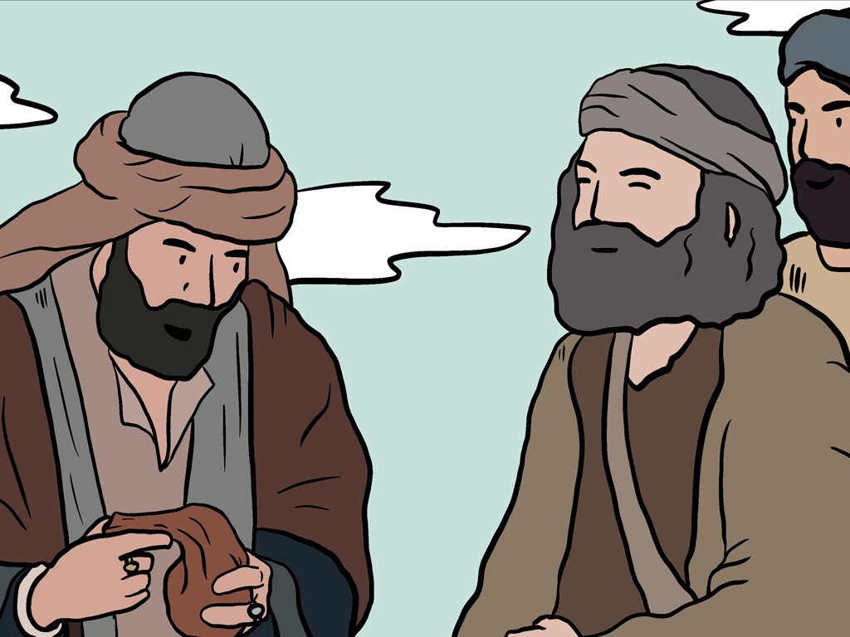
All the believers stayed together and shared everything. They sold their land and the things they owned. Then they divided the money and gave it to those who needed it.
Acts 2:44-45

Slide 10
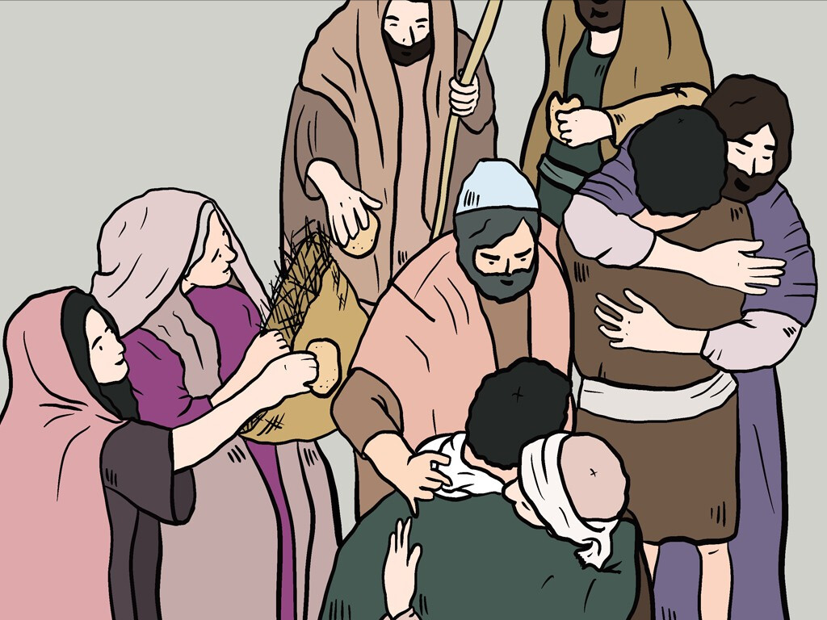
The believers shared a common purpose, and every day they spent much of their time together in the Temple area. They also ate together in their homes. They were happy to share their food and ate with joyful hearts.
Acts 2:46

Slide 11
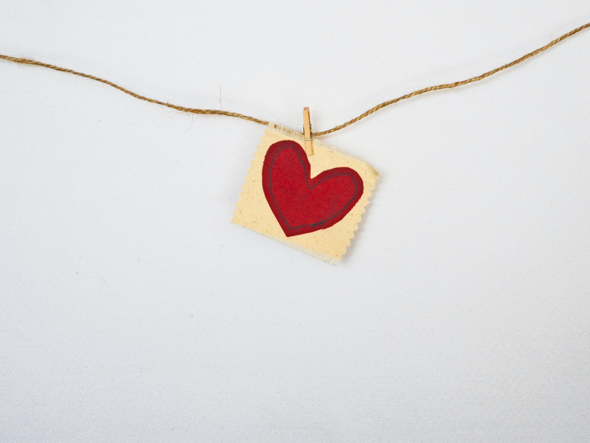
“This is my command- that you love one another as I have loved you.”
John 15:12

