Slide 3
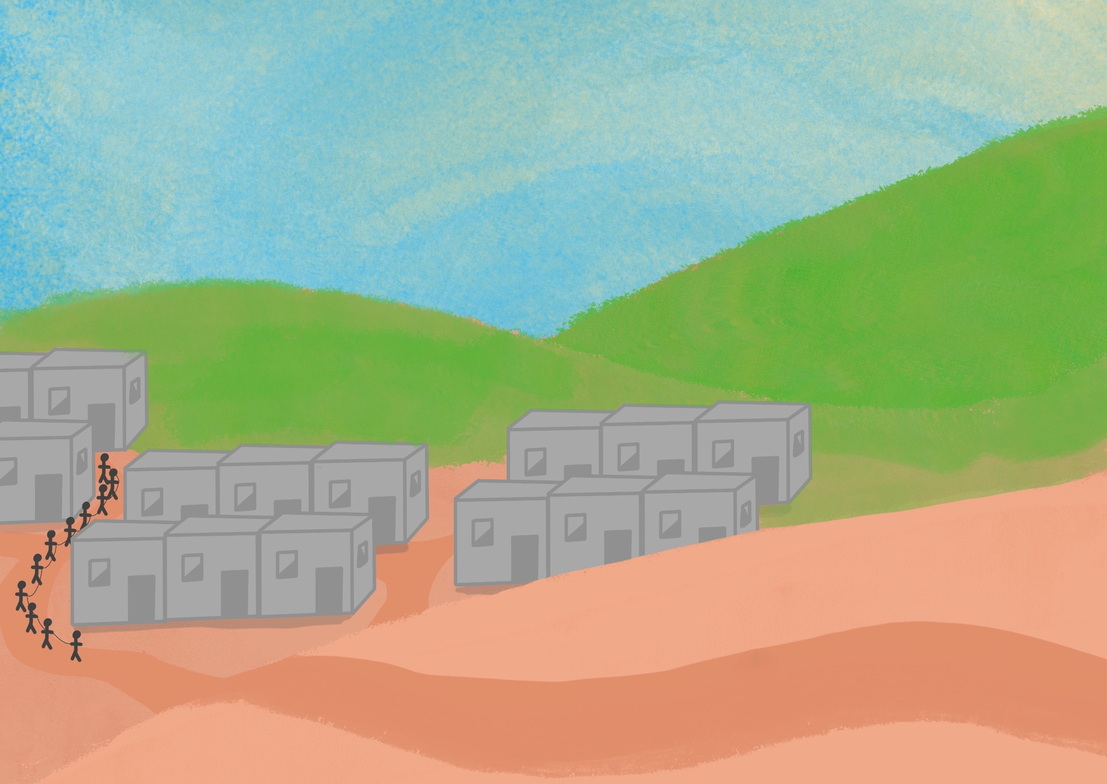

Slide 4
Their enemies came, took God’s people away,

Slide 5
God says, ‘I have not forgotten you’

Slide 7
‘I am the true and living God.’

Slide 8
‘Stop doing wrong things and come back to me.’

Slide 9
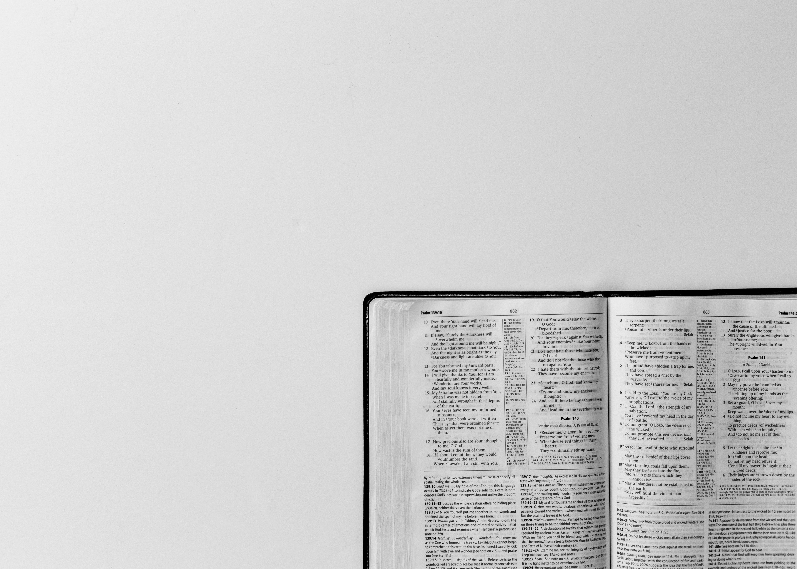
Do you not know?
Have you not heard?
The Lord
Is the everlasting God
Isaiah 40:28a

Slide 10
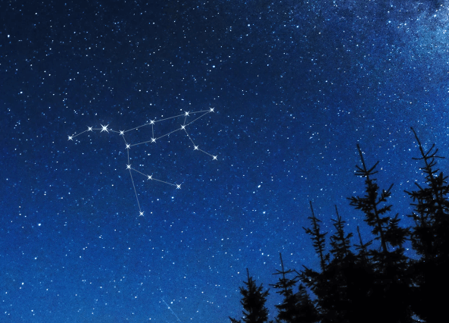

Slide 11
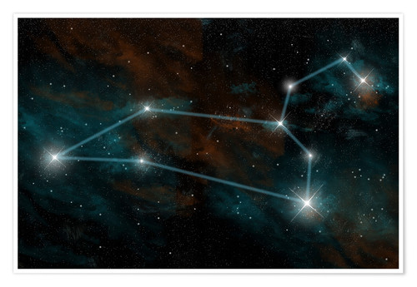

Slide 13
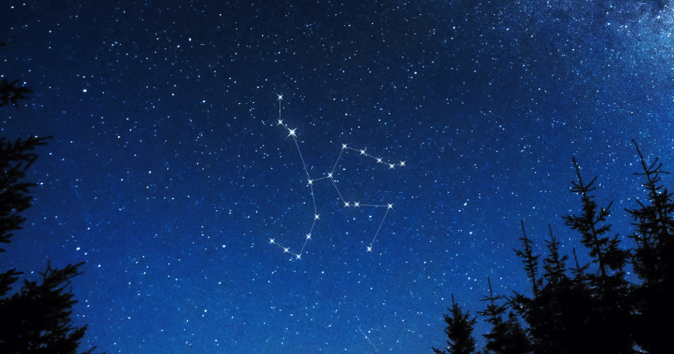

Slide 14
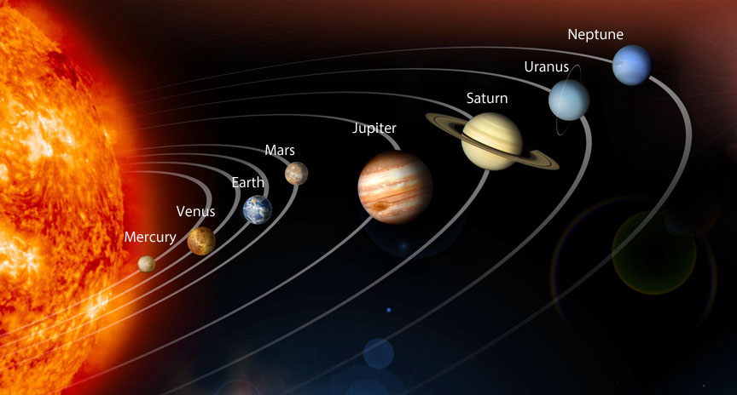

Slide 15
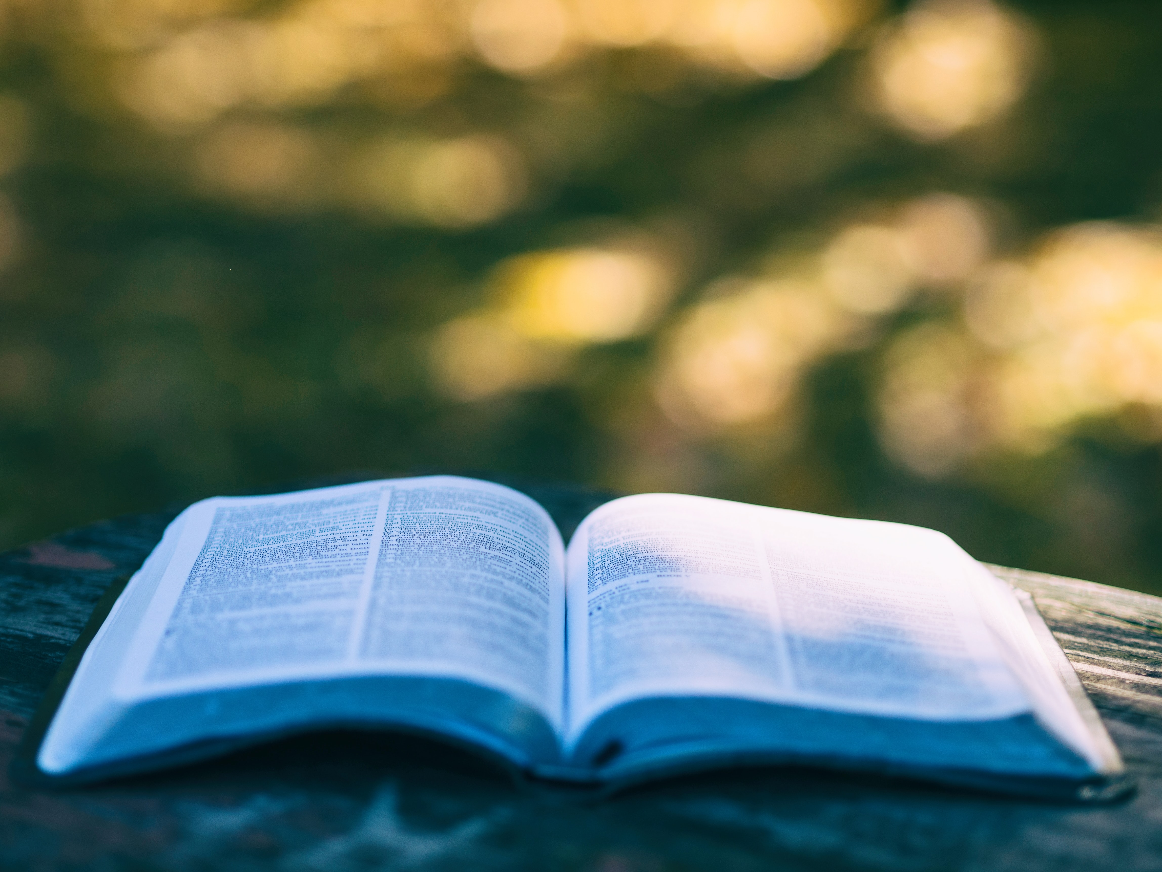
Do you not know?
Have you not heard?
The Lord is the everlasting God.
He is creator of all the earth
The Lord is the everlasting God.
He never grows tired, never grows weary
No one understands His thoughts.
He strengthens those who are weak and tired;
I’m gonna put my hope in the Lord!
Isaiah 40:28-31

