Slide 1
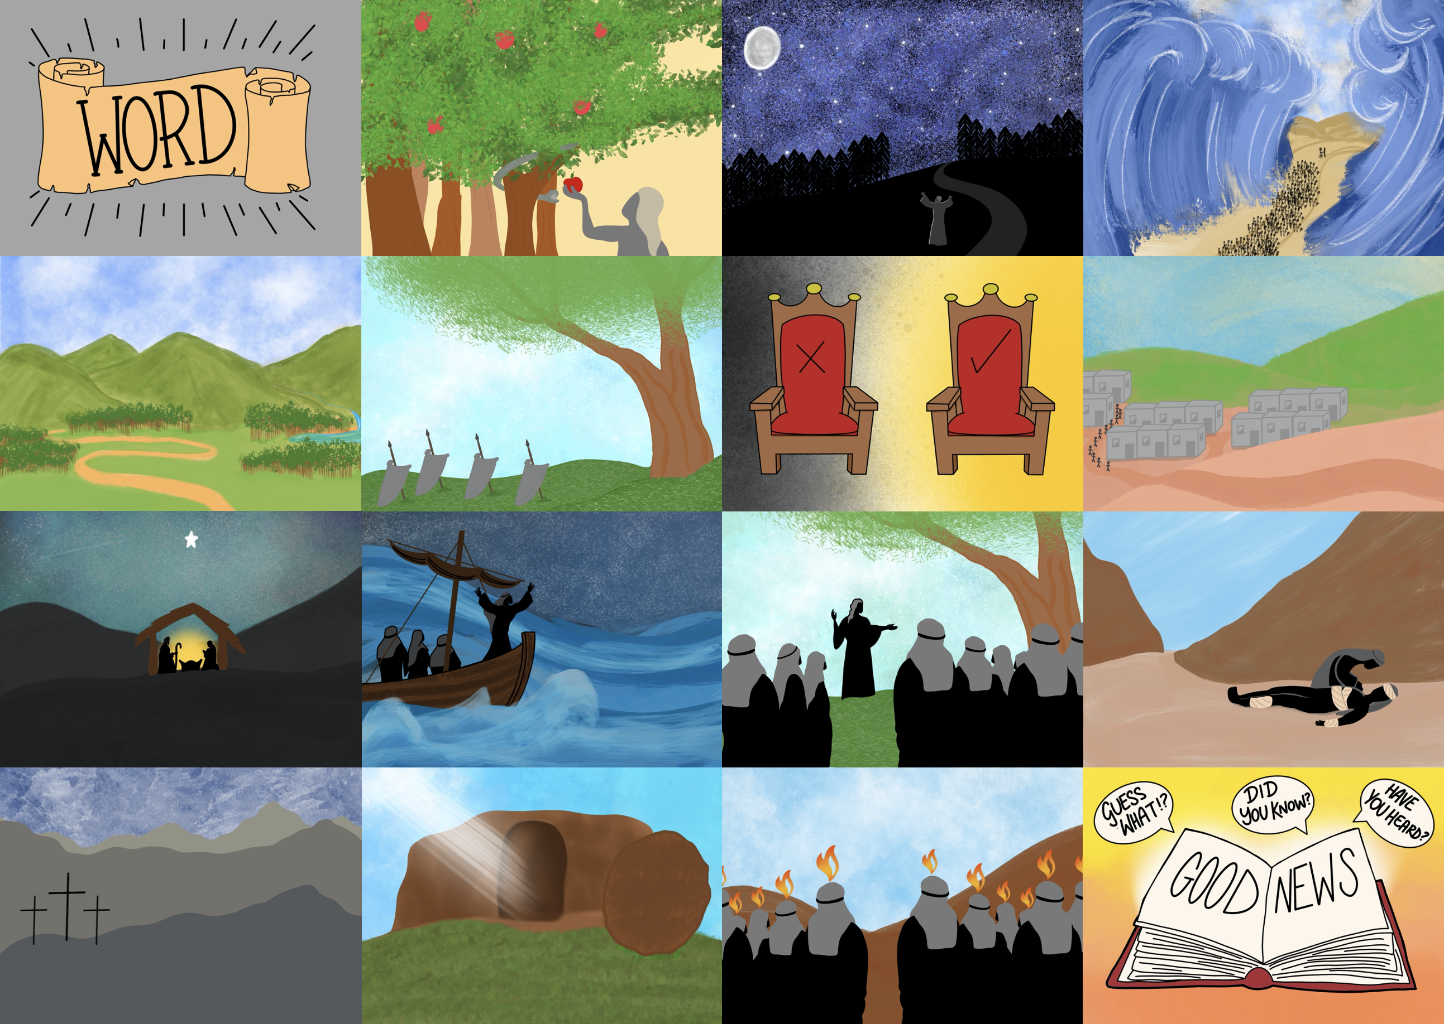

Slide 3
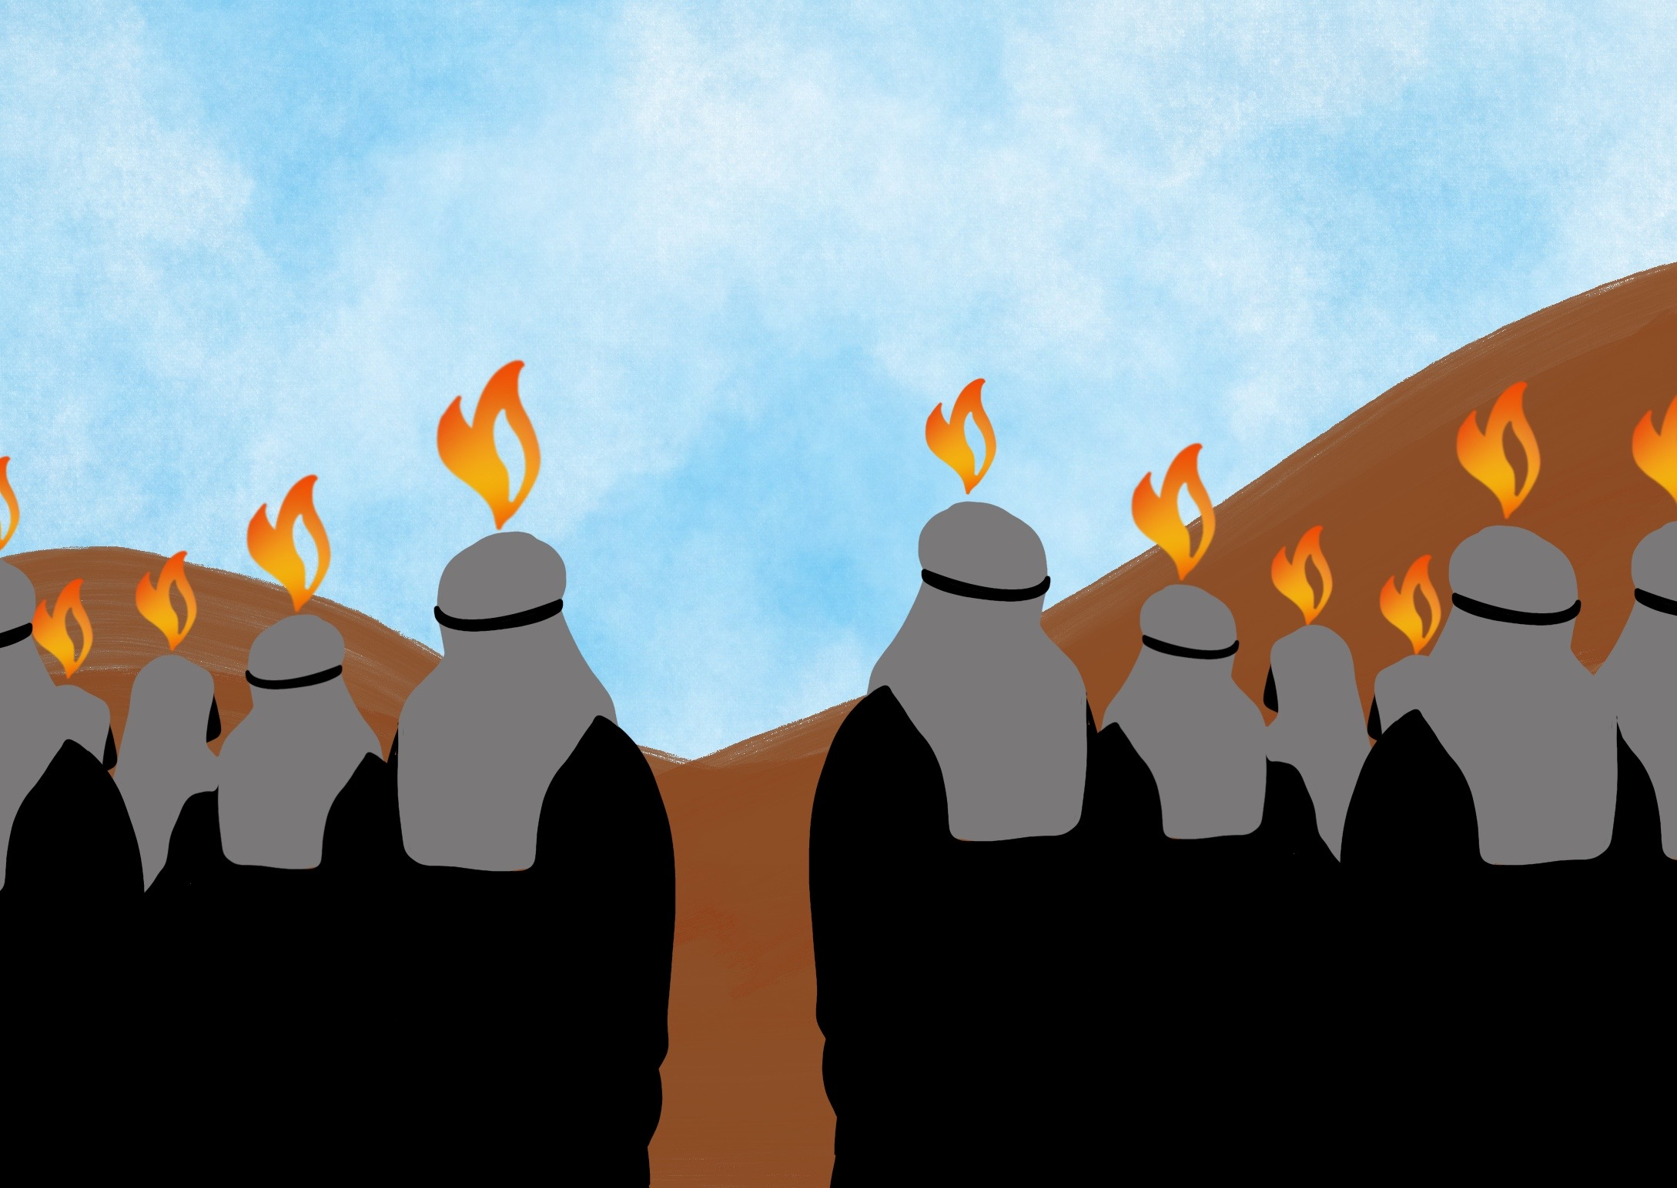

Slide 4
He has given us His Spirit to help us since then,

Slide 5
God offers his love and friendship by grace

Slide 7
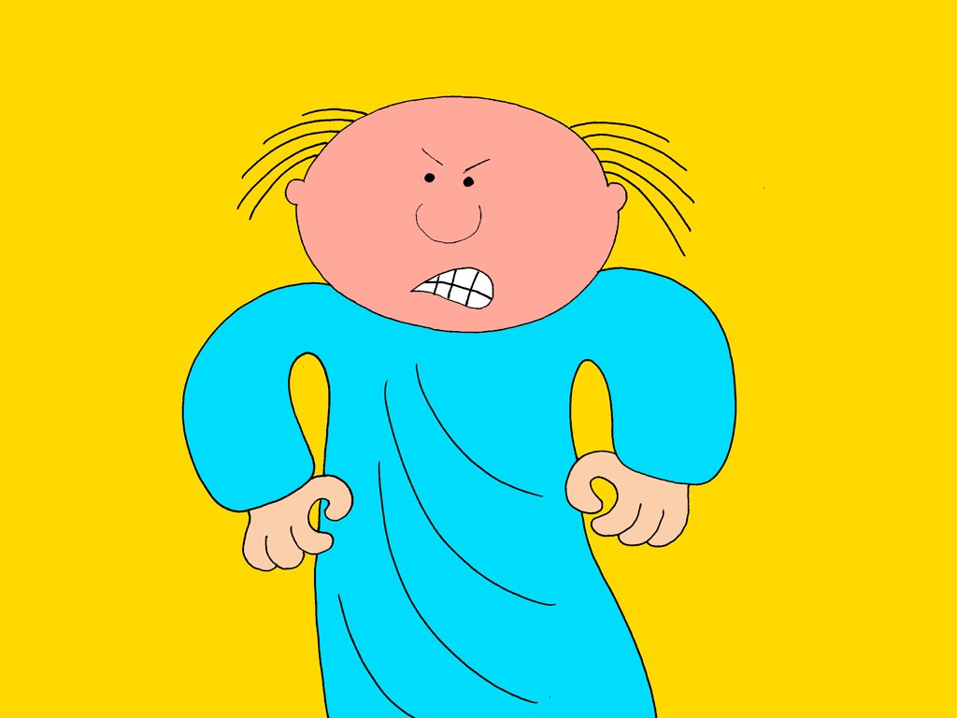

Slide 8
Some days later…

Slide 9
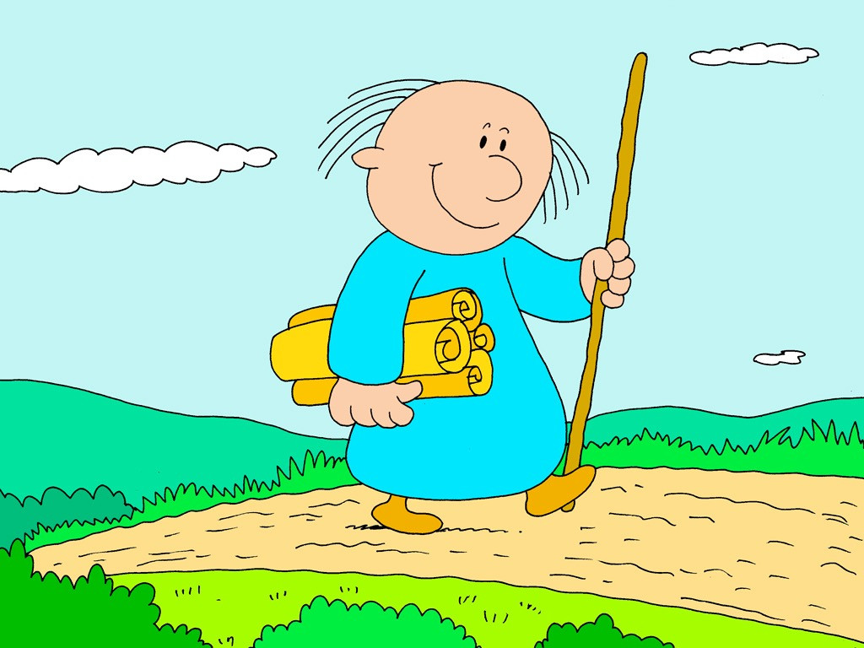

Slide 10
Believe and
Trust

