Slide 4
to spread the Good News until He comes again!

Slide 5
God offers his love and friendship to everyone

Slide 6
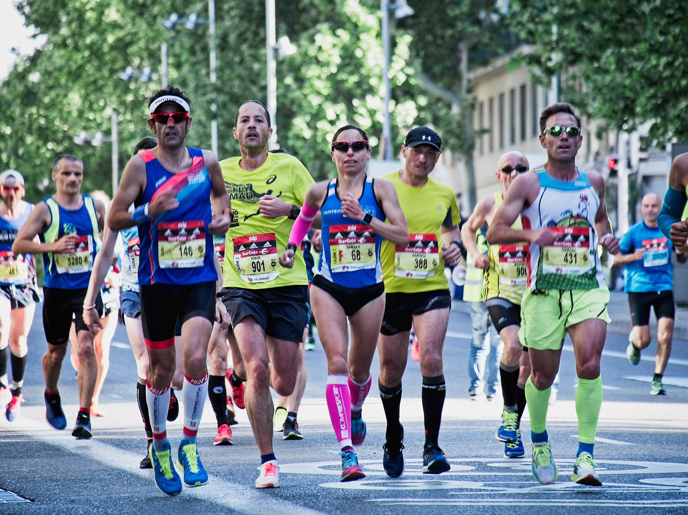

Slide 7
Greetings from Ephesus

Slide 8
Greetings from Caesarea

Slide 9
Greetings from Malta

Slide 10
